Slide 1

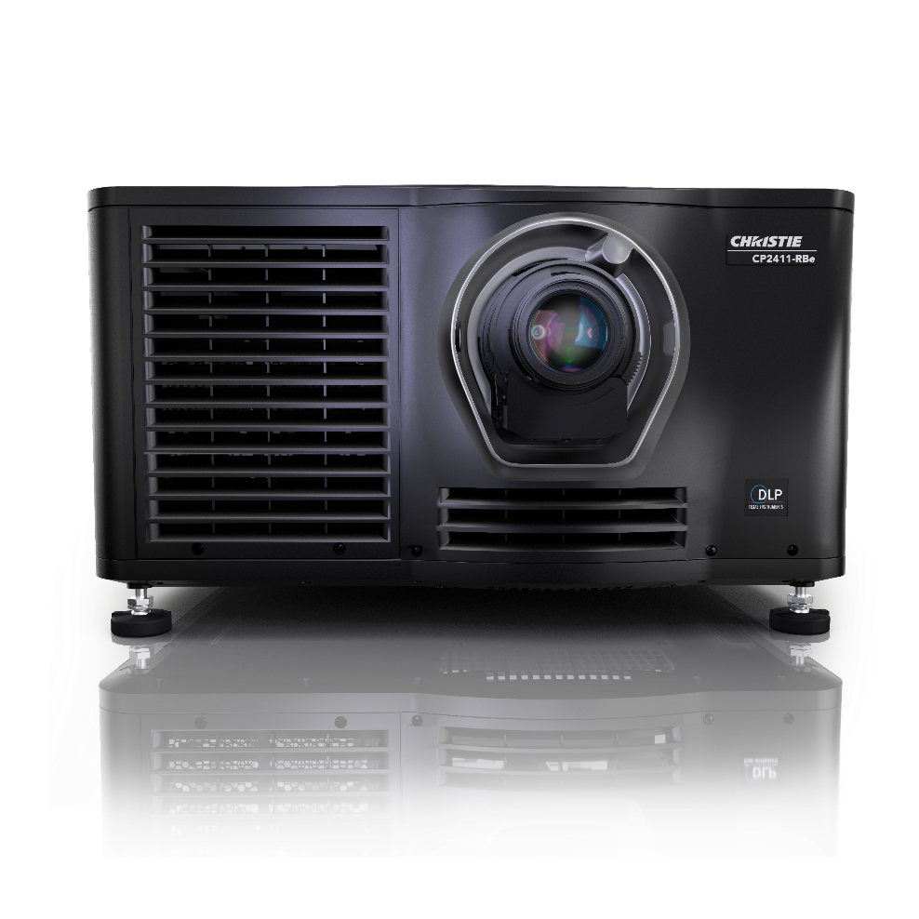

CineLife+ 2K™ Electronics CP2406-RBe, CP2409-RBe and CP2411-RBe
Notes:
NOTE to instructors: Ensure you are in PRESENTATION MODE. Otherwise the built-in links will not function.

Slide 2
CineLife+ 2K™ Electronics
Articulate the components of the Series IV (CineLife+ 2K™) Electronics.
Explain the function of each component that makes up the Electronics.
Perform a software update.

Slide 3
CineLife+ 2K™ Electronics - Agenda
Previous Cinema Electronics Overview
CineLife+ 2K Cardcage Servicing
IMB and Marriage Connectivity
CineLife+ 2K Communications
CineLife+ 2K System overview
More
Notes:
NOTE: Agenda items are hyperlinked to their respective slide.
The Menu icon in the top right corner will take you back to this slide.

Slide 4
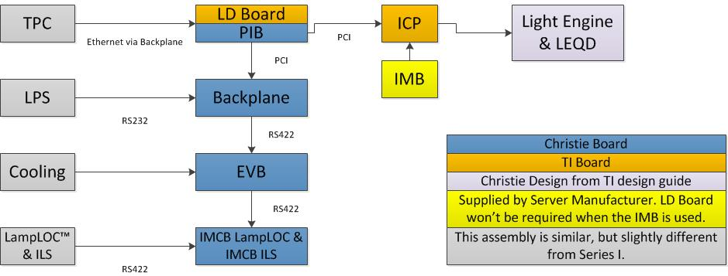
Series II Electronics
COM
COM
COM
EVB | Environmental Board (Temp. sensors, fans etc.)
ICP | Integrated Cinema Processor (FFIB and some of the processing board functions)
IMB | Integrated Media Block (Cinema Server Board)
IMCB | Internal Motor Control Board (LampLOC, ILS)
LD | Link Decryptor (Cinlink II Decryptor)
LEQD | Light Engine Quick Disconnect
PIB | Projector Intelligence Board (PCM and some of the interface board functions)
LPS | Lamp Power Supply
Notes:
NOTE: This is meant as an overview primarily for those who are not familiar with Series II Electronics. We recommend that a learner participate in a Series II class prior to a CineLife+ class.
Alternative content → via DVI
Cinema →
Traditional Server – Stores Content, Manages Content SMS, Security Manager (decrypts encrypted content).
SERVER → encrypts video (to ensure only a cinema projector can play content) → Link Decryptor (LD) → video to ICP
IMB – Storage → SM → Video (no need to encrypt the Video because the content has not left the projector) → ICP
TPC and IMB both have UIs for control
ICP and LD are TI boards, the system architecture was mainly designed by TI

Slide 5
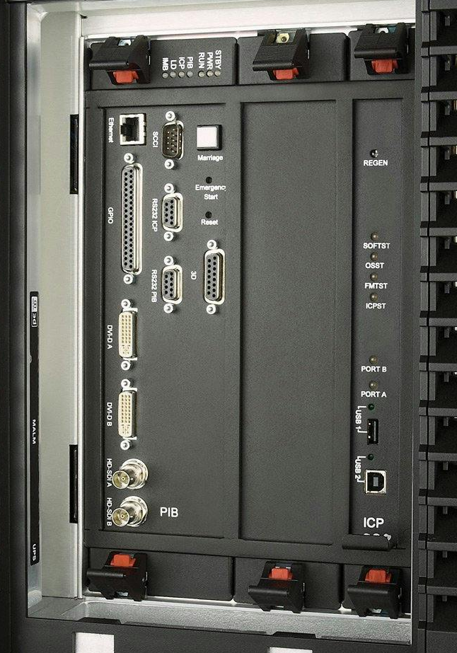
Series II Electronics
Notes:
2 routers and a switch are required to manage the communication between the system components.
The routing to the IMB still valid in Cine Life and Cine Life Plus Electronics

Slide 6
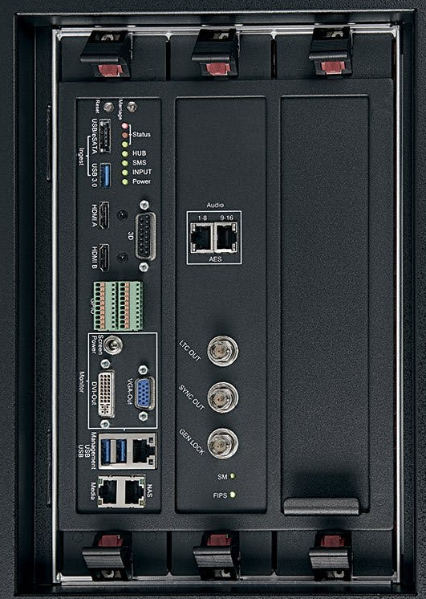
CineLife Electronics

Slide 7
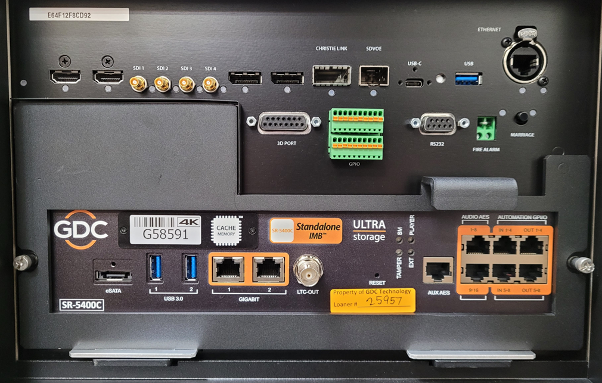
CineLife+ Electronics
CAVE
Control And Video Electronics
VOM
Variable Option Module
IMB

Slide 8
CineLife+ Electronics
HKBB or HKBG
Light Source
Control
Fan Control
LOS 2
(if applicable)
Notes:
CAVE and HKBB/G are always ON.
All other boards can be turned ON / OFF in the software. For Cinema application, all boards except for the laser devices and the light engine are ON at all times AC is applied to the LVPS

Slide 9
CineLife+ 2K™ Electronics - Agenda
Previous Cinema Electronics Overview
CineLife+ 2K Cardcage Servicing
IMB and Marriage Connectivity
CineLife+ 2K Communications
CineLife+ 2K System overview
More

Slide 10
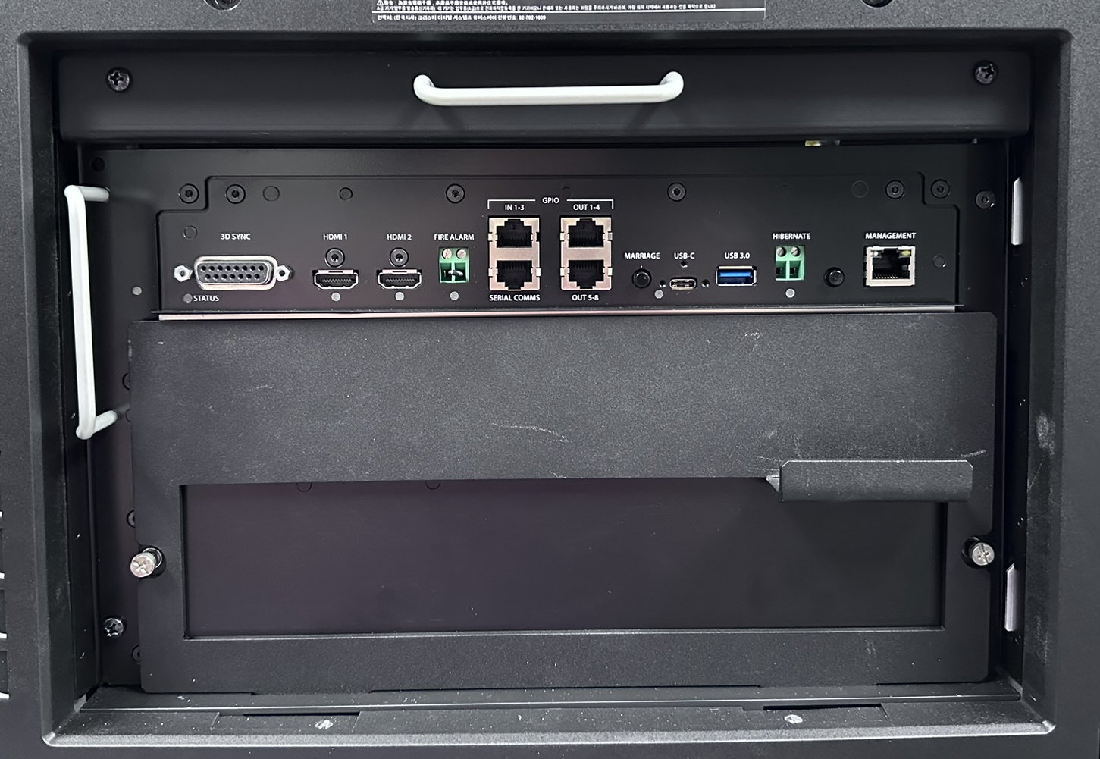
CineLife+ 2K System Overview
The CineLife+ 2K Cardcage:
New Series IV Cardcage that will support “-RBe” series of projectors.
Since the “-RBe” models have a 2K resolution, they technically don’t need the 4K processing power that’s in a CineLife+ cardcage.
The CAVE-2K is the main “board” in a new CineLife+ 2K cardcage. It is capable of processing video up to 2K @120Hz. It is able to accept 4K @60Hz, but will downscale (due to DMD size).

Slide 11
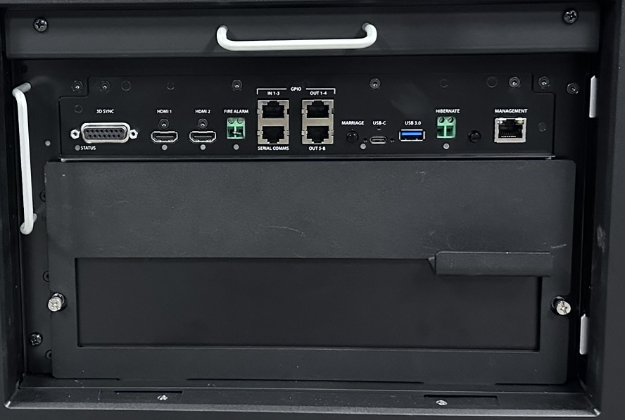
CineLife+ 2K System Overview
CineLife+ 2K Cardcage:
CAVE-2K
Control And Video Electronics
Note: We no longer have a VOM
(Variable Option Module)
IMB (Integrated Media Block) Slot
Notes:
Note: CAVE-2K (Control and Video Electronics board) is often also referred to as the Common Audio Video Electronics Board

Slide 12
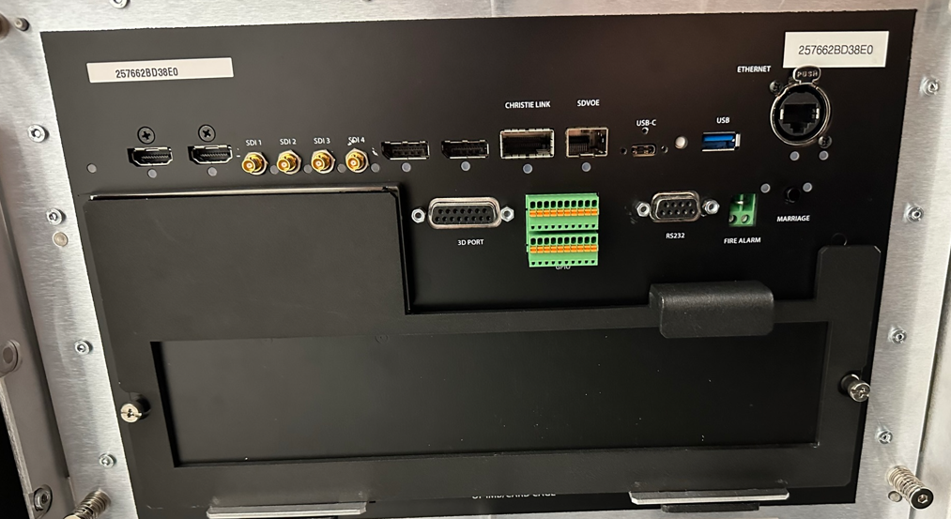
CineLife+ 2K System Overview
The CineLife+ 2K Cardcage:
A few differences that we’ll notice when comparing these two cardcages:
CineLife+ 2K has DisplayPort and SDI connectors removed.
CineLife+ 2K does NOT have a VOM anymore (Variable Option Module).
CineLife+ 2K uses ethernet ports as our GPIO instead of the green connector from our CineLife+ models.
We have a new connector called “Hibernate”.
We have a different marriage ring.
RS23 port on VOM has been removed.
CineLife+ Cardcage
CineLife+ 2K Cardcage

Slide 13
CineLife+ 2K System Overview
Features:
Higher processing bandwidth
IMB-S4 2K120 (Optional Accessory)
Support for alternative input 2K
Built-in Automation
GPIO (General Purpose Input / Output), over Ethernet connection.
“Rental Mode” features for supporting rental/leasing business models
Secure certificate-based licensing for projector controls (i.e. illumination system, signal inputs, time-based operation etc.)
Disabled by default
Notes:
The system can support single projector 3D at 60 FPS/eye @ 2K resolution when the media block supports it.

Slide 14
CineLife+ 2K “Rental Mode” Details
Features:
Primarily intended to enforce payment for facilitating rental/leasing deals
Allows a projector illumination source or alternative input ports to be disabled
After a specific number of “illumination on” hours;
After a specific number of “projector on” hours; or
After a specific calendar date
Uses a highly secure system of Keys and Licenses controlled by operating hours or expiry date
Projectors ship from factory with rental mode disabled: “unlocked”
i.e. projector will work normally and indefinitely
Notes:
NOTE: Availability TBD

Slide 15
CineLife+ 2K Key Features
IMB Compatibility:
Support for IMBs from multiple vendors
GDC SR-1000
GDC SR-6400/5400C
GDC SX-4000
Dolby IMS2000/IMS3000
….more

Slide 16
CineLife+ 2K™ Electronics - Agenda
Previous Cinema Electronics Overview
CineLife+ 2K Cardcage Servicing
IMB and Marriage Connectivity
CineLife+ 2K Communications
CineLife+ 2K System overview
More

Slide 17
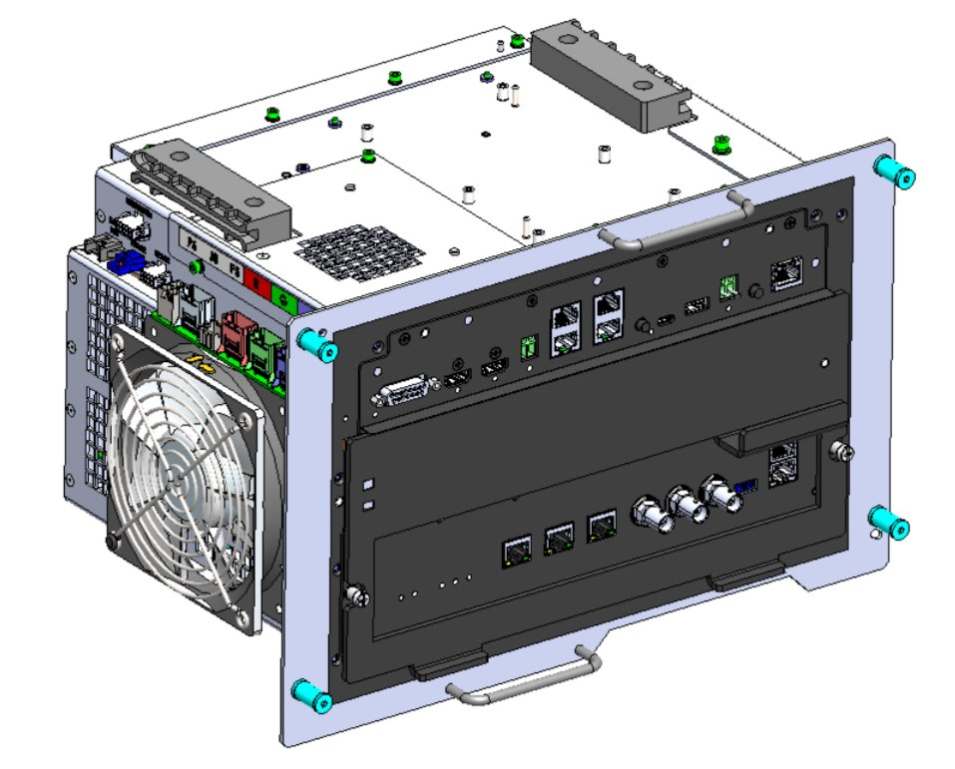
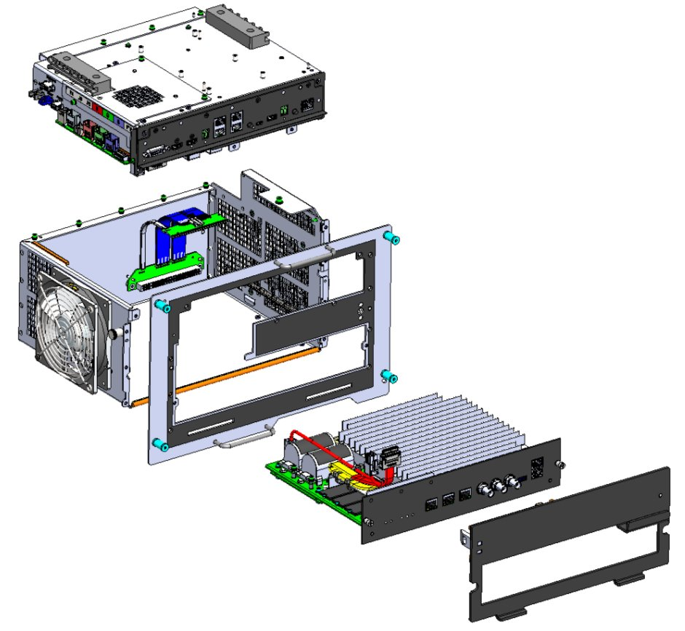
CineLife+ 2K System Overview
The CineLife+ 2K Cardcage:
The CineLife+ 2K Cardcage can be disassembled to remove the CAVE-2K module.
This was not an option for the CineLife+ (4K) cardcage.

Slide 18

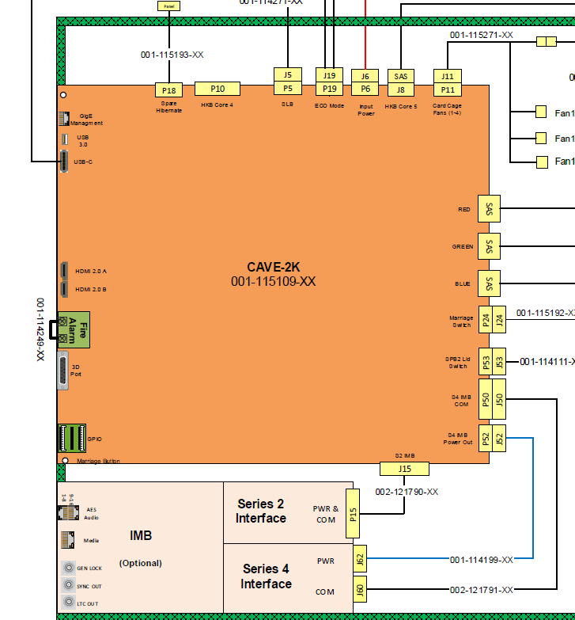
CineLife+ 2K System Overview
CAVE-2K Removal:
To remove the CAVE-2K, we would first want to disconnect all harnesses and then remove a total of 3-screws securing the cardcage to our projector.

Slide 19
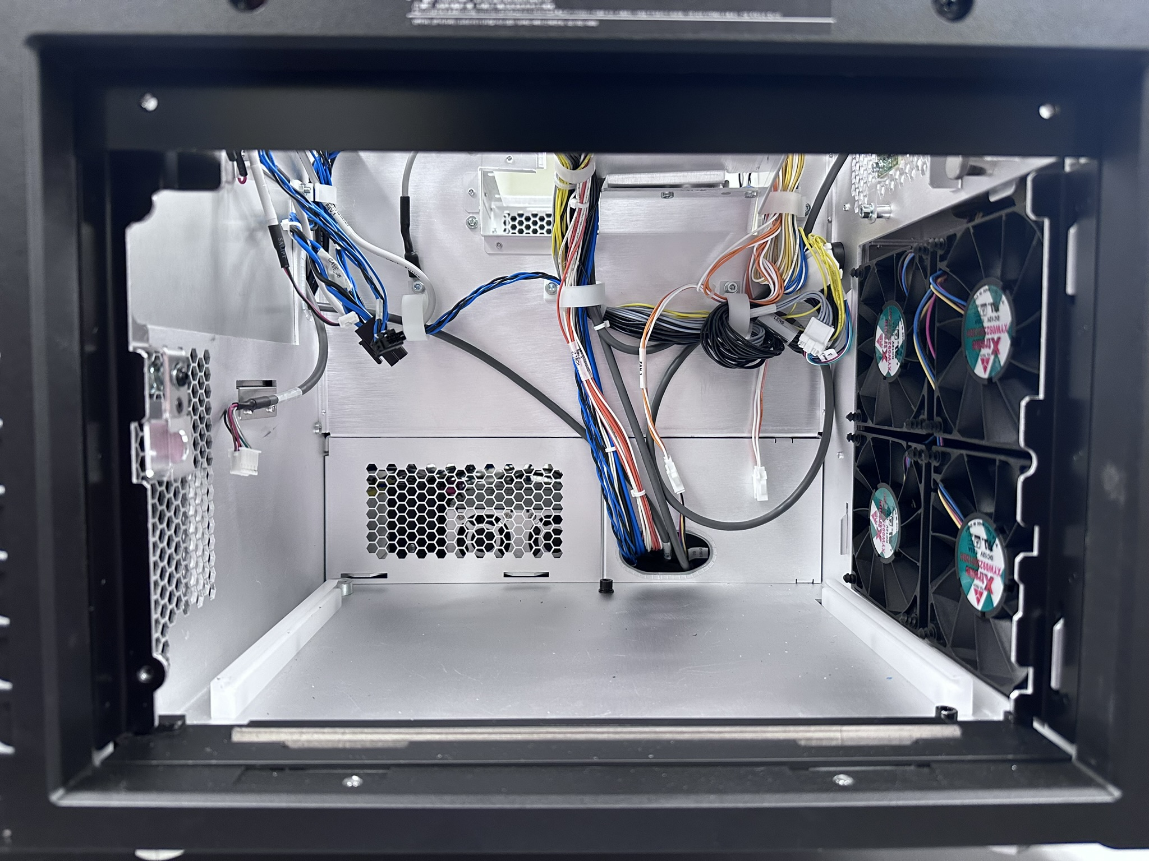
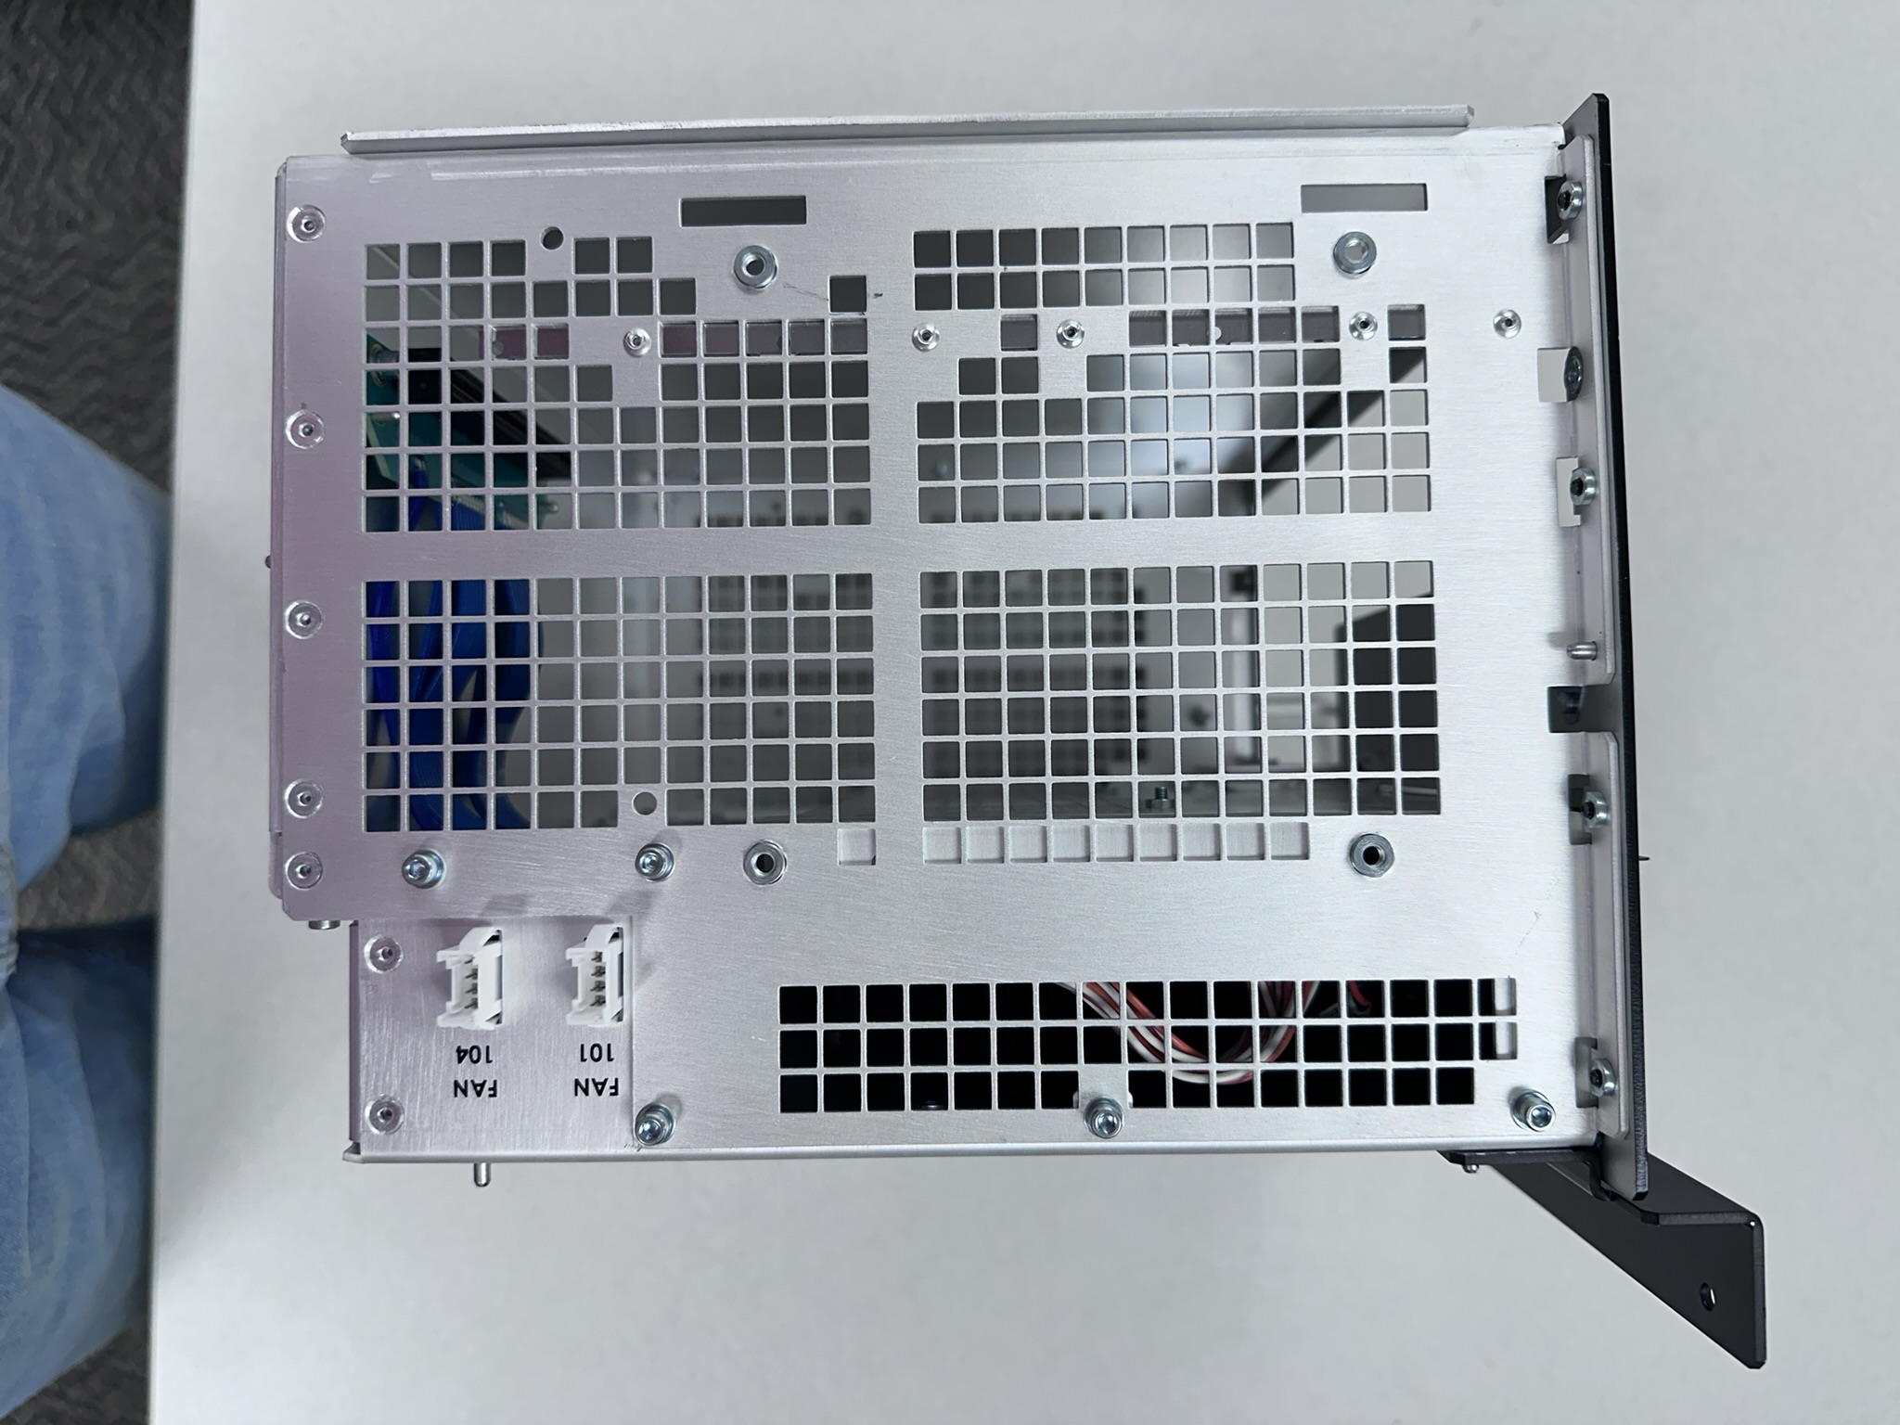
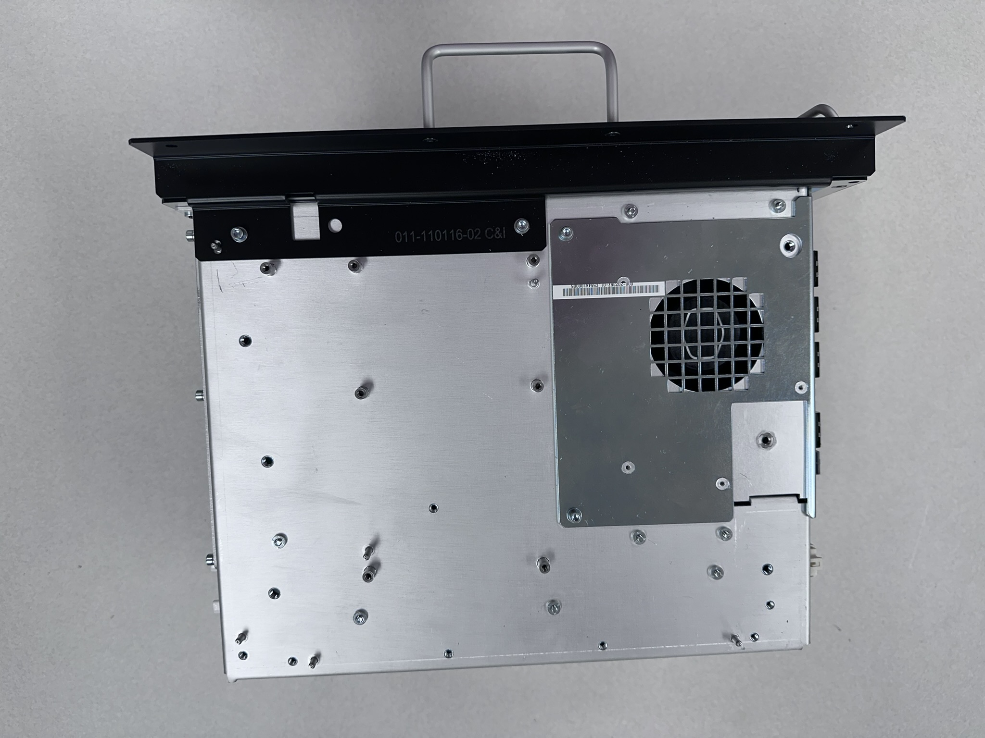
CineLife+ 2K System Overview
CAVE-2K Removal:
Here we can see that the cardcage removed from a projector:

Slide 20
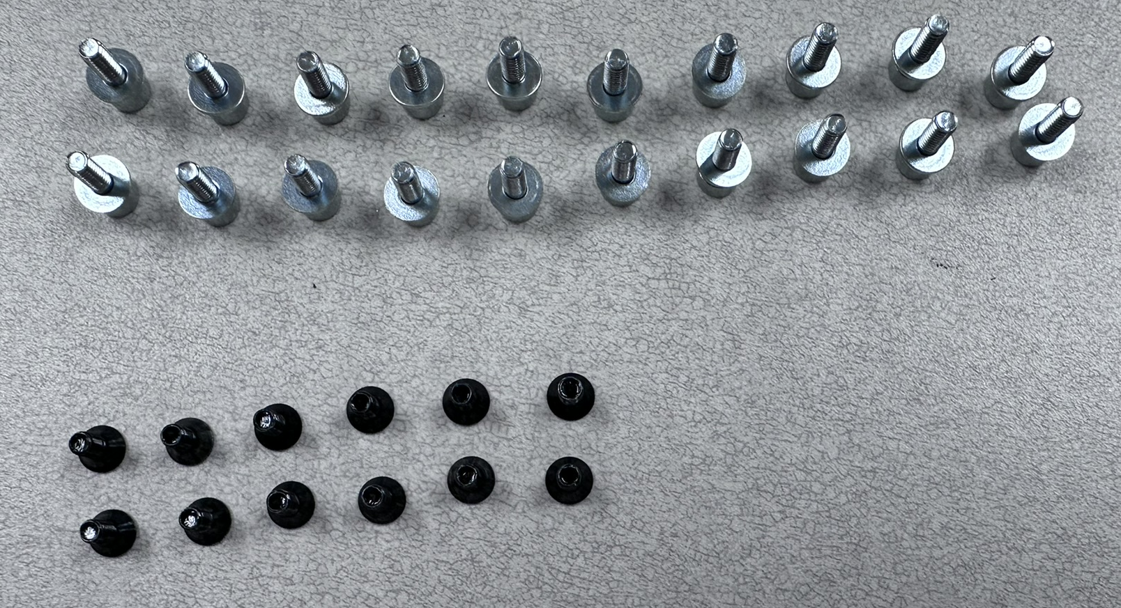
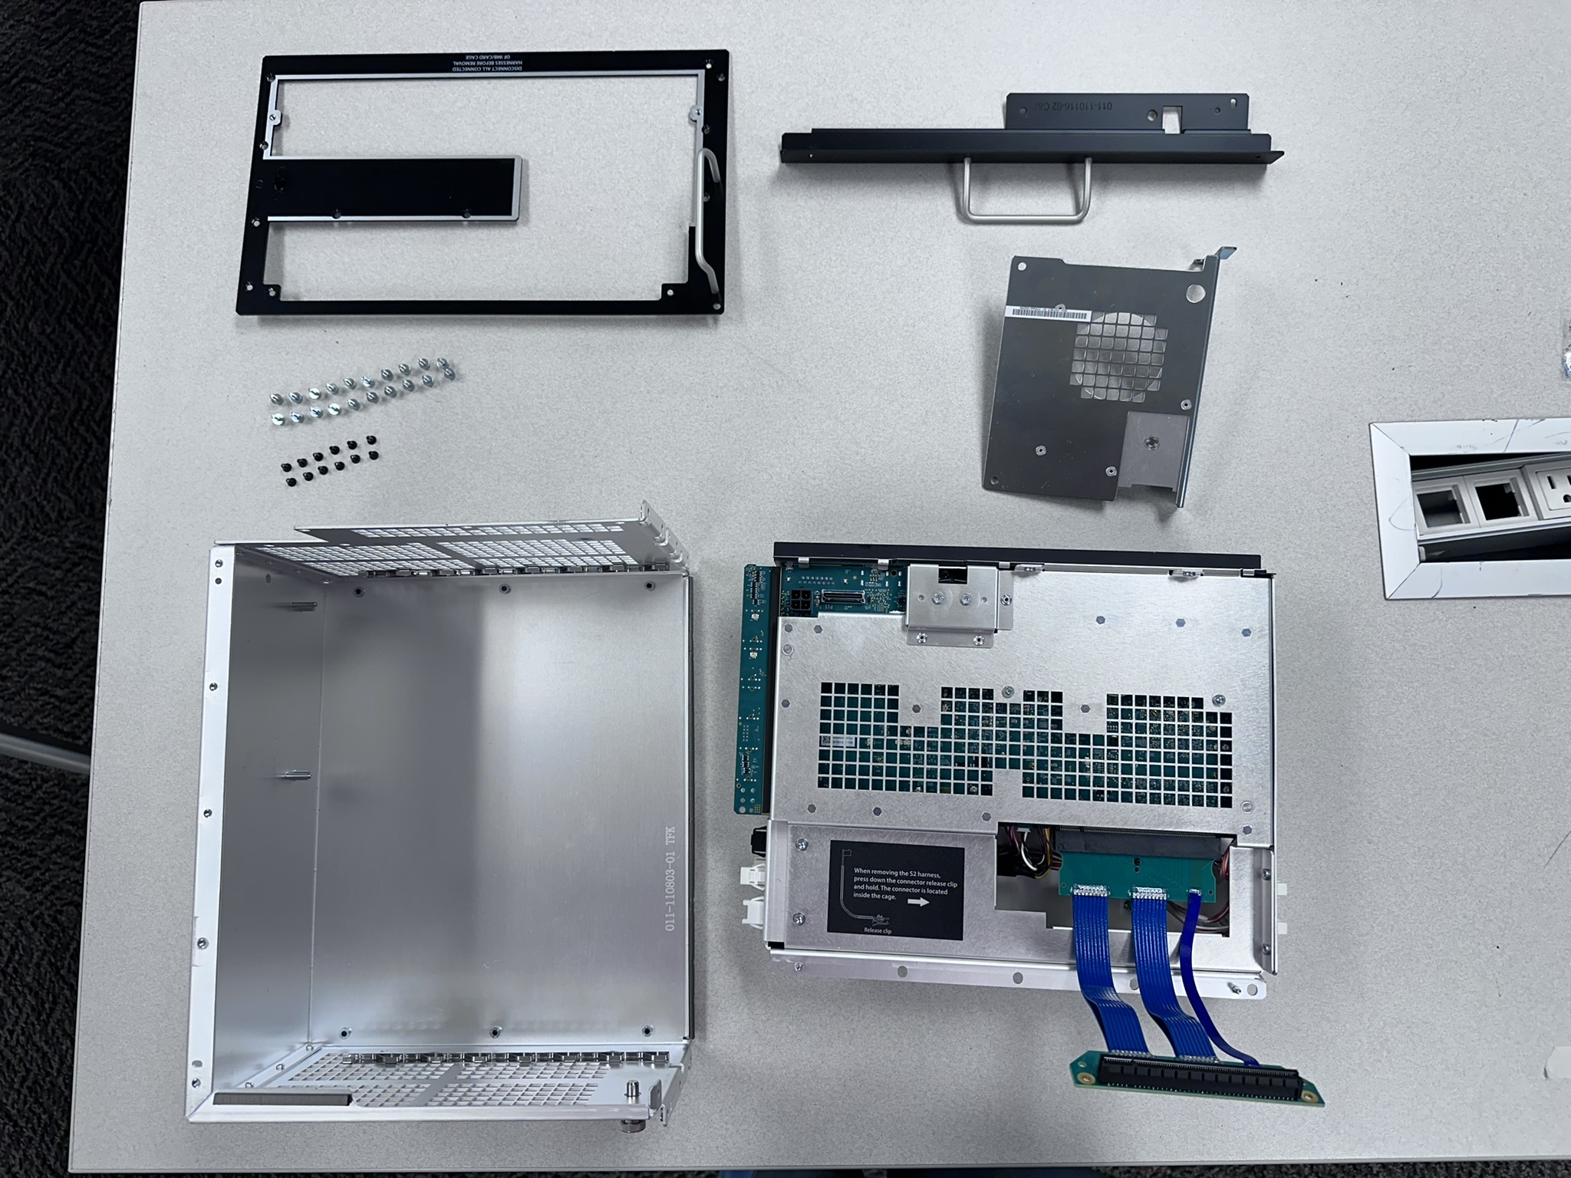
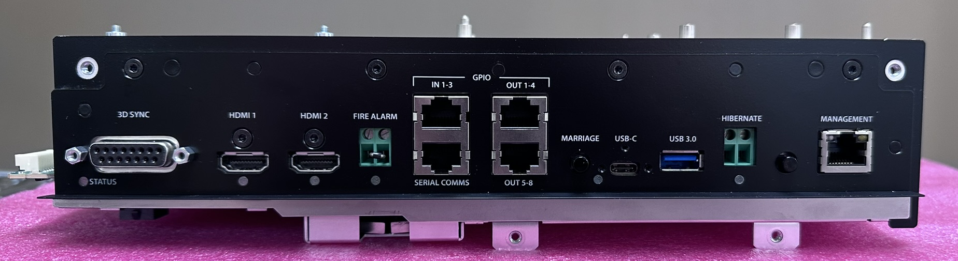
CineLife+ 2K System Overview
CAVE-2K Removal:
After the CAVE-2K has been removed from the cardcage, we need to remove a total of 32 screws to remove the CAVE-2K module from the cardcage.
12 being black 2mm hex screws
20 being silver 2.5mm screws

Slide 21
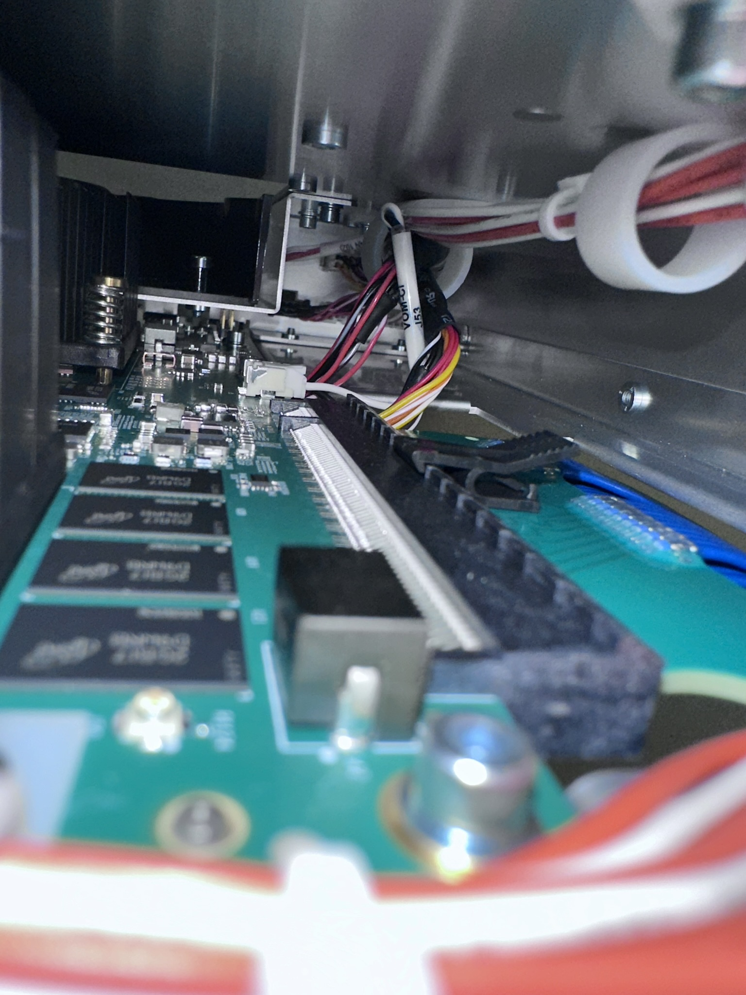
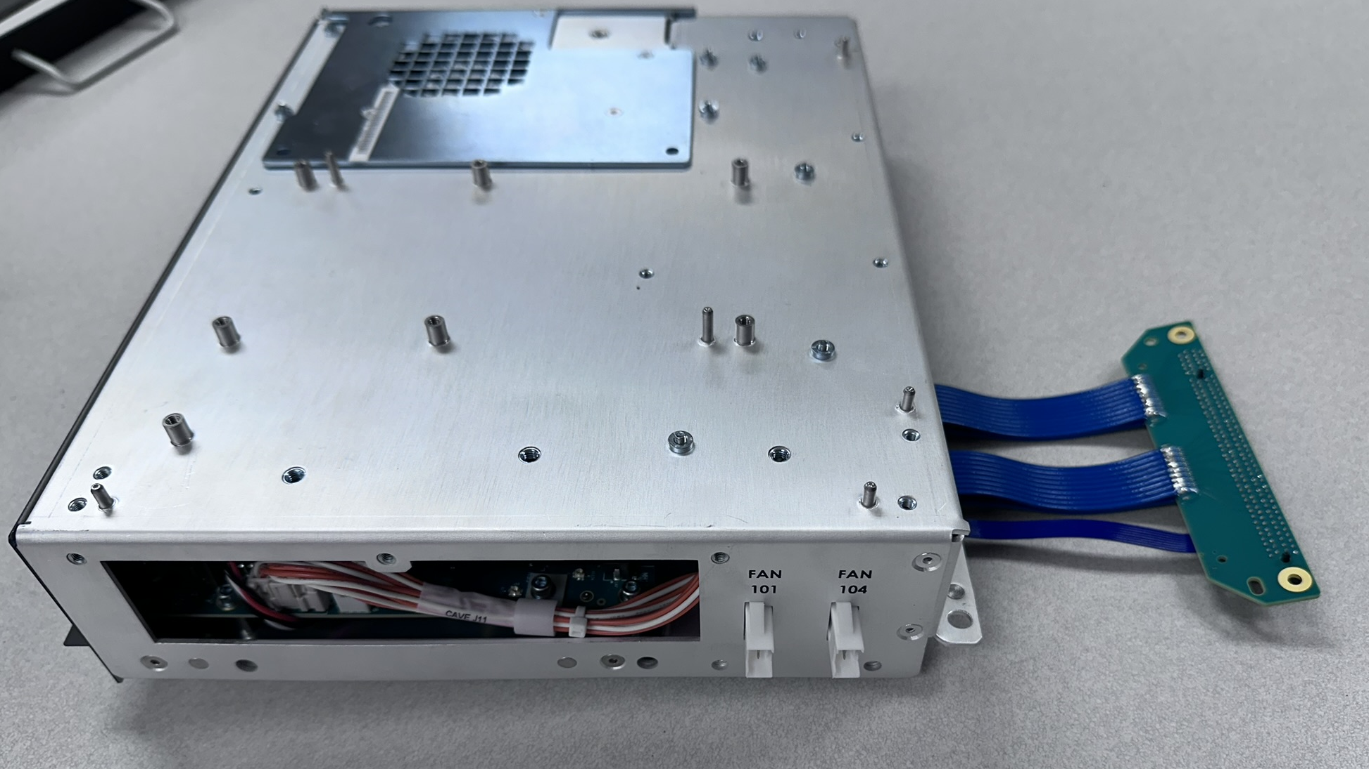
CineLife+ 2K System Overview
CAVE-2K Removal:
The IMB-S2 interface connection is secured to the CAVE-2K module. If you want to remove the IMB-S2 interface harness, it can be done by accessing it’s connection tab inside the module.
Simply press on the back of the back of the release tab for removal

Slide 22
CAVE-2K
CAVE-2K Cardcage and Standard CineLife+ (4K) Cardcage:
The CineLife+ and CineLife+ 2K cardcages, are mechanically just about identical.
We do not have the option of swapping in a CineLife+ Cardcage in place of a CineLife+ 2K cardcage (or vice versa).
The CineLife+ and CineLife+ 2K Cardcage have different connectors (ex: DisplayPort, Hibernate, etc.) which can certainly cause complications if trying to swap a CineLife+ cardcage with a CineLife+ 2K cardcage.
There are software differences between the CineLife+ and CineLife+ 2K cardcage as well which would prevent a replacement so we should never attempt to perform this replacement.

Slide 23
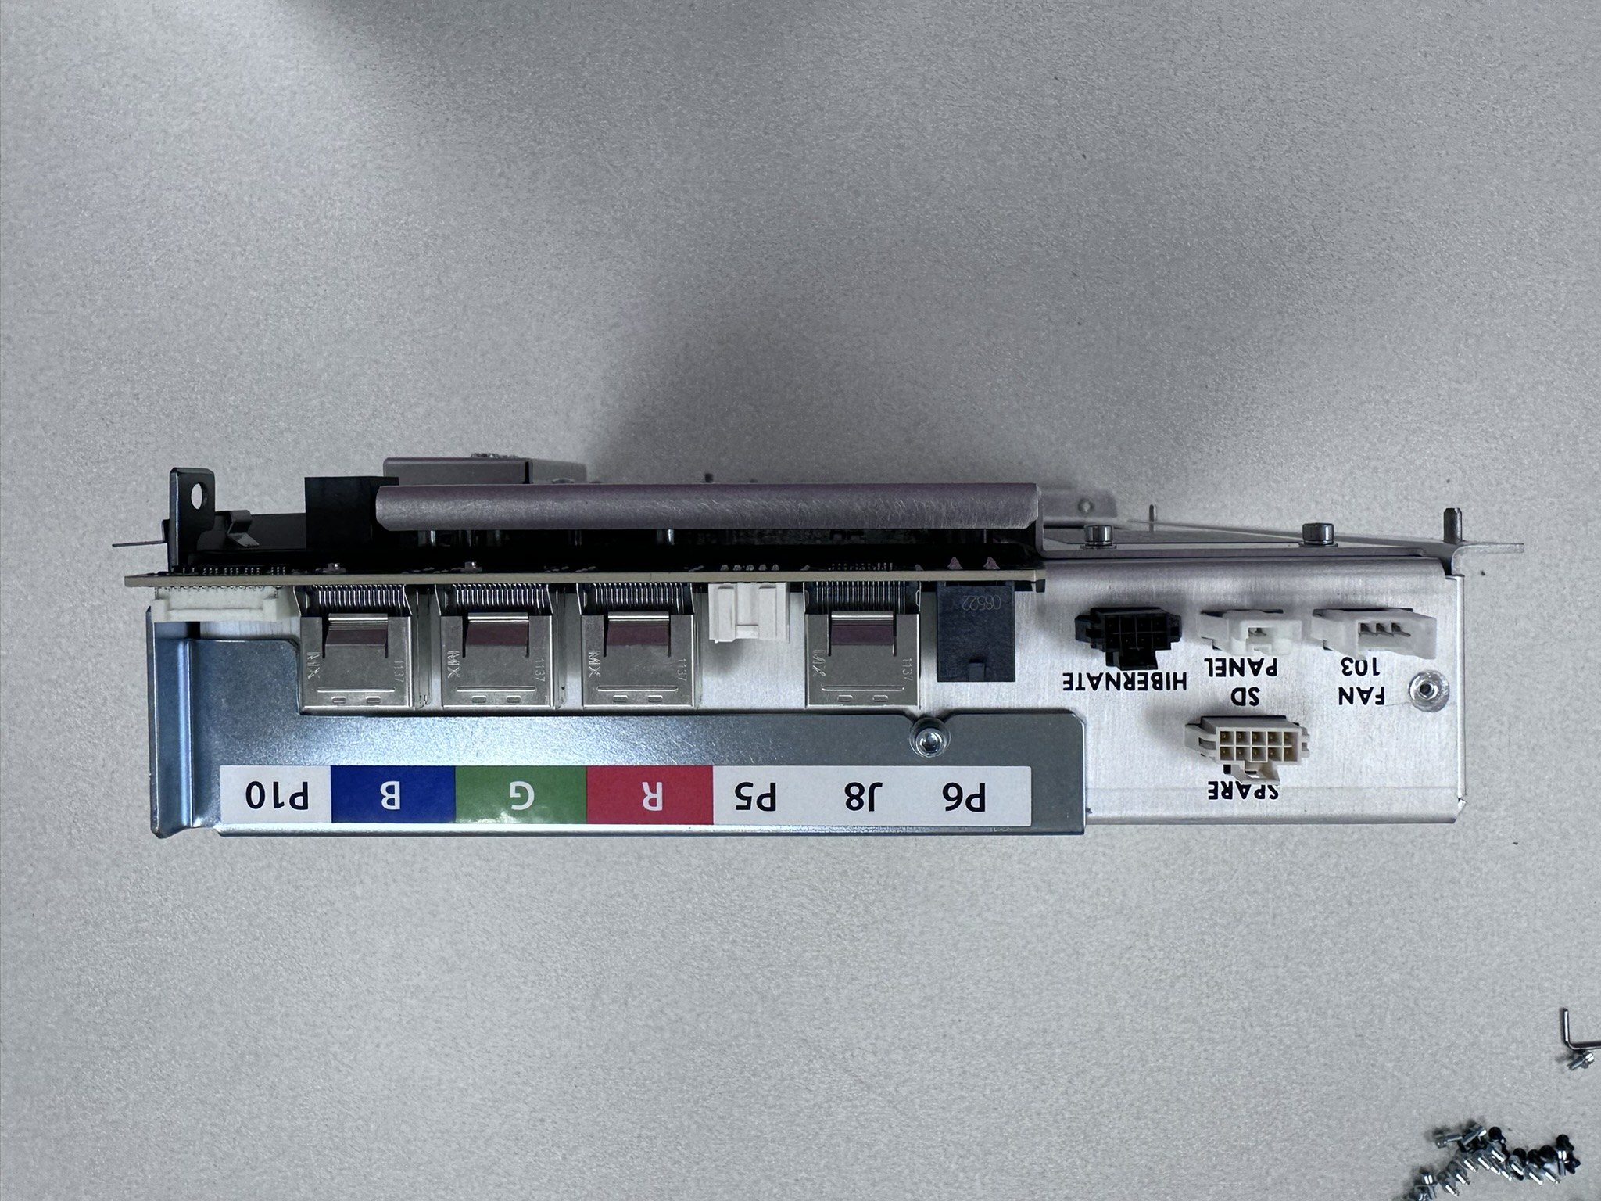
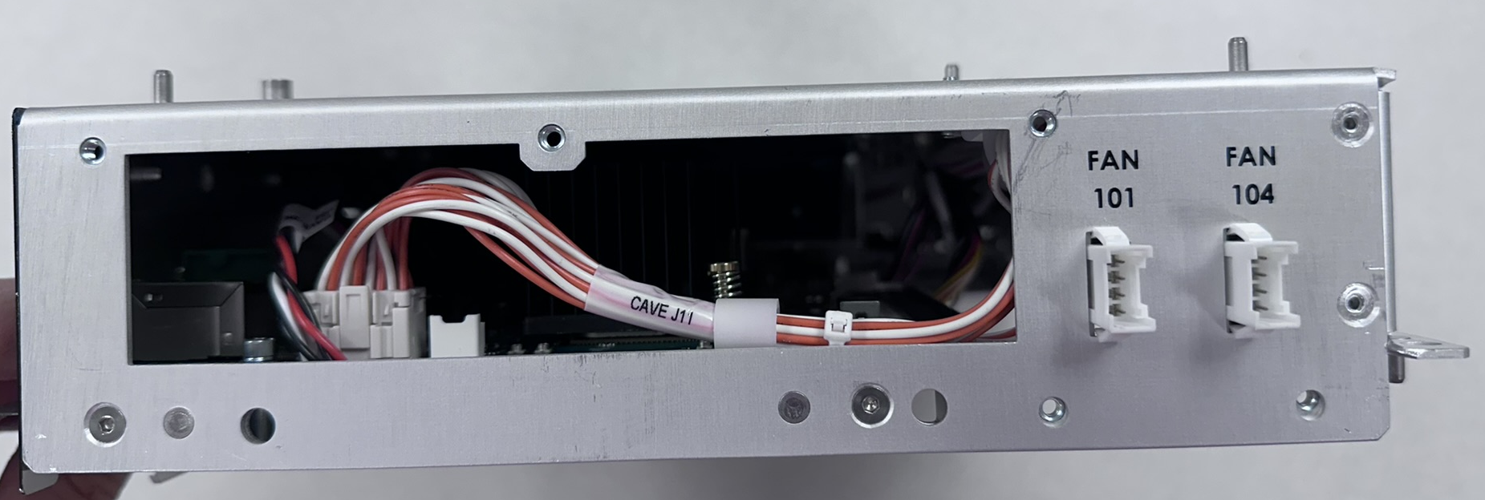
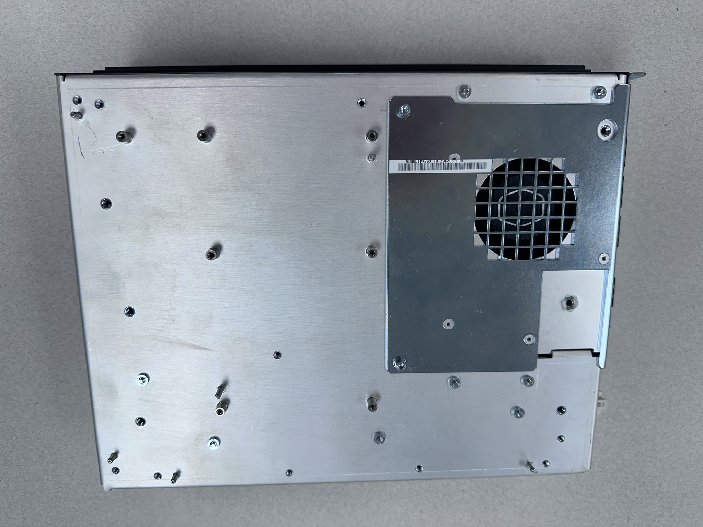
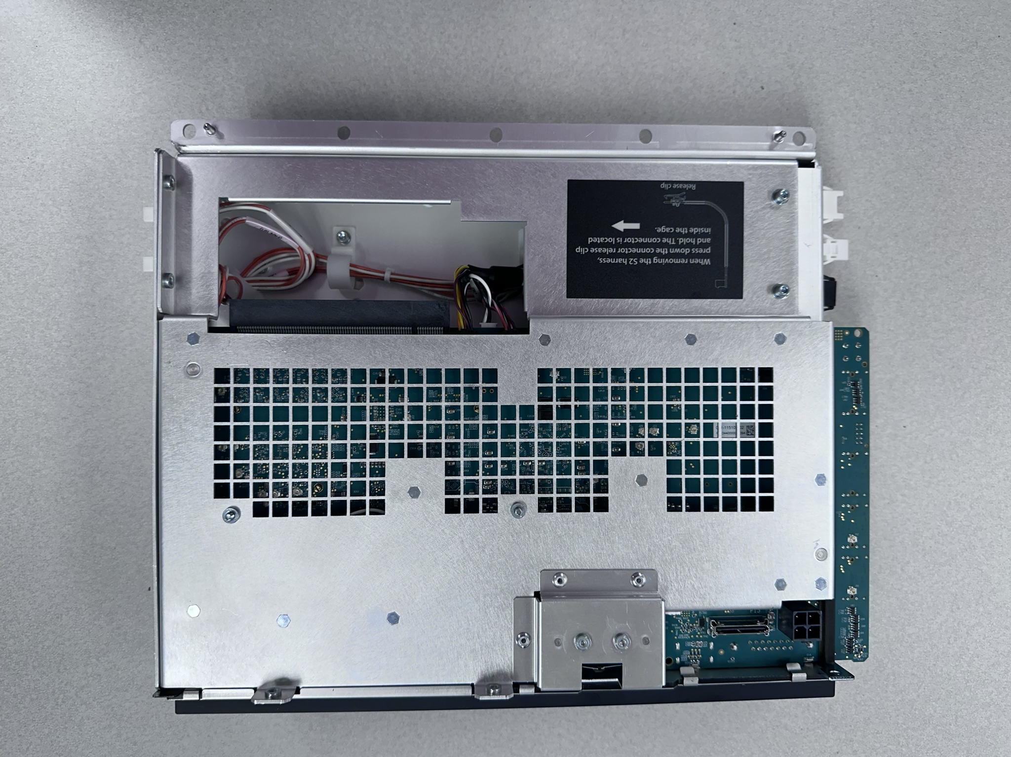
Control And Video Electronics (CAVE)
The CAVE is the main controller, System Software and User Settings are stored on the CAVE
CAVE-2K Connectivity:
Front
Not Used
Input Power
SLB
Red CFB
Blue CFB
Service Door (SPB1)
HKBG
Green CFB
Not Used
Top
Bottom
Not Used
Not Used
Notes:
The CAVE-2K board provides the following functions
Provides the user interface for the projector.
Configure video processing FPGAs on other boards in the system.
Control the House Keeping Board-Type G (HKBG).
Run projector firmware/software upgrades.
Provide a frame buffer appropriate for 2K @ 120 fps.
Perform scaling of the active video source.
Store and protect a projector certificate. (Secure silicon circuit)
Controls the Status Light Board (SLB)

Slide 24
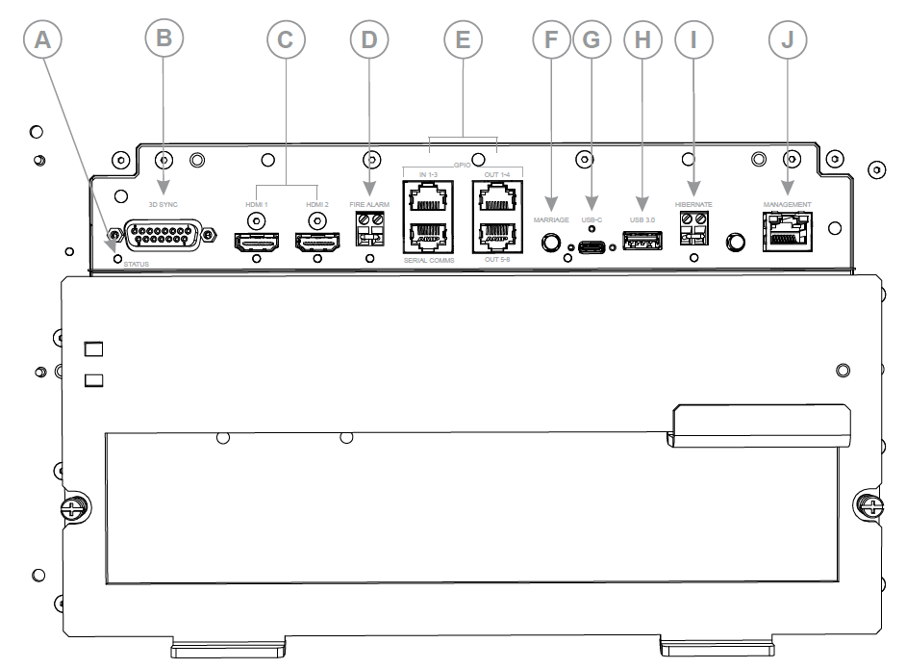
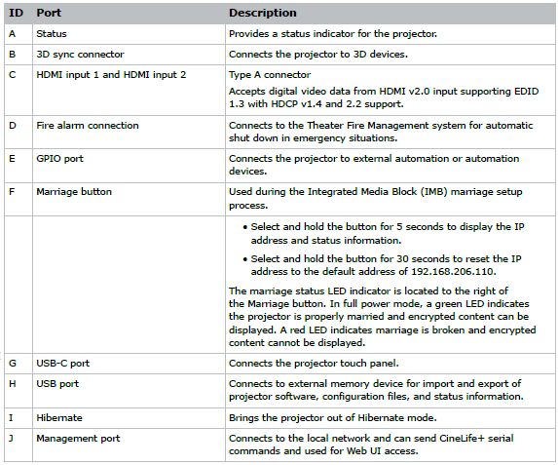
CineLife+ 2K System Overview
CAVE-2K Faceplate:

Slide 25
CineLife+ 2K™ Electronics - Agenda
Previous Cinema Electronics Overview
CineLife+ 2K Cardcage Servicing
IMB and Marriage Connectivity
CineLife+ 2K Communications
CineLife+ 2K System overview
More

Slide 26
CineLife+ 2K System Overview
Network Connectivity:
Light Source Controller (HKBG)
Serial
Ethernet

Slide 27
CineLife+ 2K System Overview
CineLife+ 2K Management Ports:
21 – FTP
80 – HTTP (Web)
5000 – Christie Serial Interface Port
5111 – Automation Messages
5900 – VNC Port 1
6901 – VNC Port 2
6902 – VNC Port 3
6903 – VNC Port 4

Slide 28
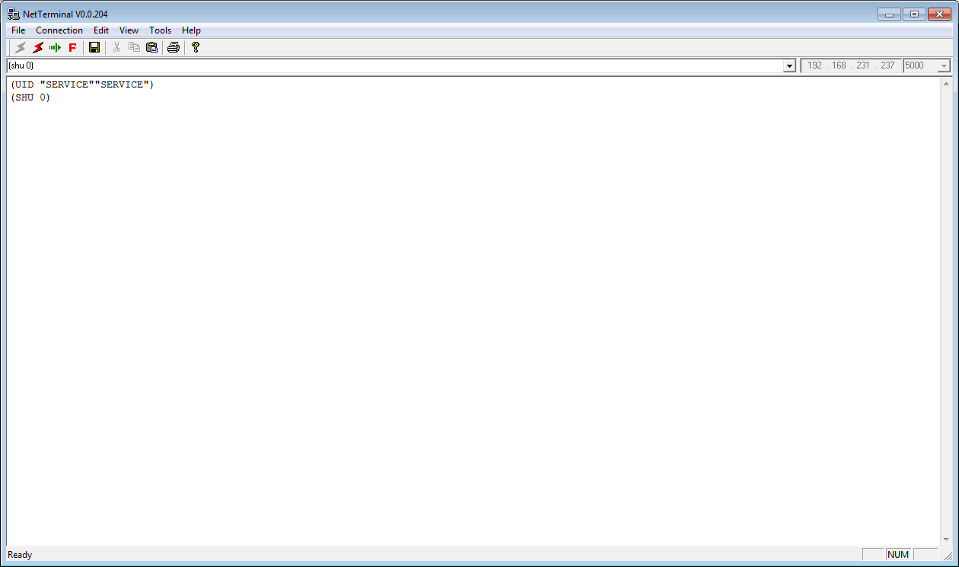
CineLife+ 2K System Overview
Communications:
We can send serial API’s to the projector over port 5000
Technical Reference: Serial Commands document
Notes:
We can send serial APIs to the projector on port 5000.

Slide 29
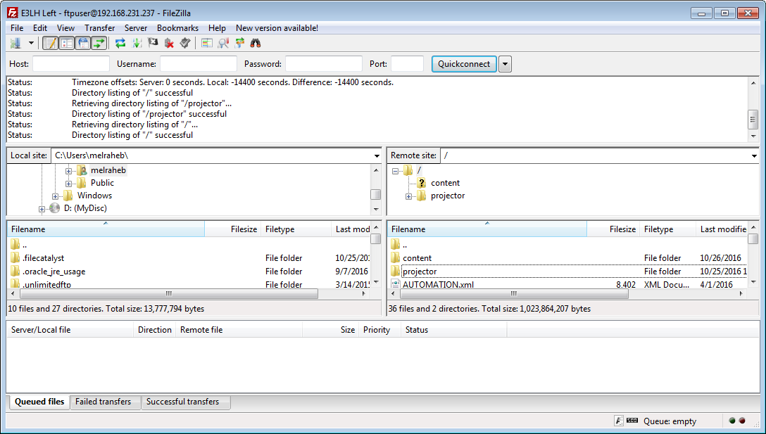
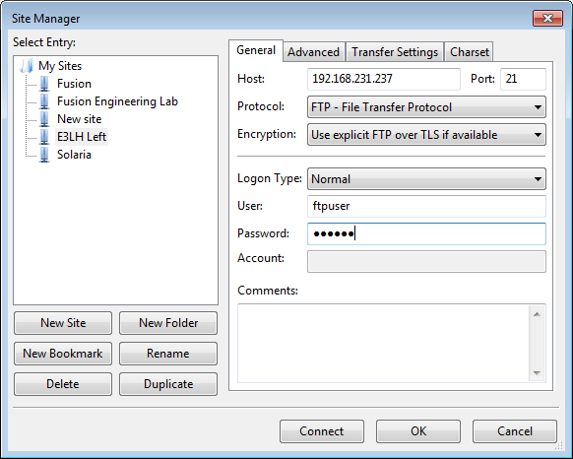
CineLife+ 2K System Overview
FTP:
We’re still able to FTP to our projector in order to upload upgrade packages, download interrogator logs, etc.
Notes:
We can FTP files to/from the projector using port 21.
Username: ftpuser
Password: ftptms
This function can be used to upload upgrade packages to the projector or download the interrogator logs.

Slide 30
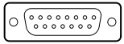
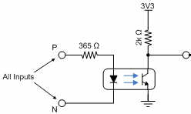
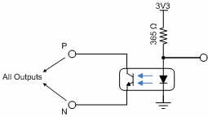
CineLife+ 2K System Overview
3D Port:
Pin # | Christie Name | Input/ Output | Description
1 | +12V | Output | Power to 3D device. Maximum 1A (total between both +12V pins)
2 | GND |  | Ground
3 | GND |  | Ground
4 | RS232_RX | Input | Data to Projector from 3D device. 115200 Baud, 8 bits, no parity.
5 | RS232_TX | Output | Data to 3D device from Projector. 115200 Baud, 8 bits, no parity.
6 | CONN_3D_MODE + | Output | 3D mode state from projector. To projector GPO collector. Compatible with current projector GPIO requirements and restrictions. (24VDC max, 50mA max) 3-D On = Hi logic level = O/P transistor ON 3-D Off = Low Logic level = O/P transistor OFF
7 | CONN_SYNC+ | Output | SYNC from projector. To projector GPO collector. Compatible with current projector GPIO requirements and restrictions. (24VDC max, 50mA max)
8 | 3D_INPUT_REFERENCE+ | Input | 3-D L/R Input Reference (P) (Voltage limit: 1.4VDC to 12VDC)
9 | +12V | Output | Power to Real D product. Maximum 1A (total between both +12V pins)
10 | 3D_INPUT_REFERENCE- | Input | 3-D L/R Input Reference (N) (Voltage limit: 1.4VDC to 12VDC)
11 | 3D_DISPLAY_REFERENCE+ | Input | 3-D L/R Display Reference (P) (Voltage limit: 1.4VDC to 12VDC)
12 | 3D_DISPLAY_REFERENCE- | Input | 3-D L/R Display Reference (P) (Voltage limit: 1.4VDC to 12VDC)
13 | CONN_3D_MODE- | Output | 3D mode state from projector. From projector GPO emitter. Compatible with current projector GPIO requirements and restrictions. (24VDC max, 50mA max)
14 | CONN_SYNC- | Output | SYNC from projector. From projector GPO collector. Compatible with current projector GPIO requirements and restrictions. (24VDC max, 50mA max)
15 | N/C |  | Not connected
Notes:
3D Port Pin Out

Slide 31
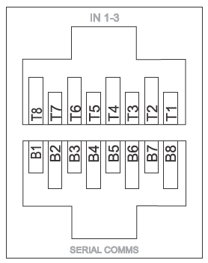
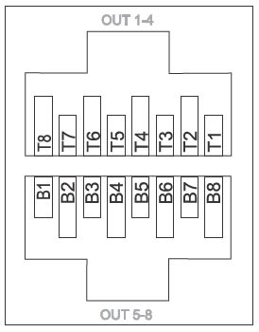
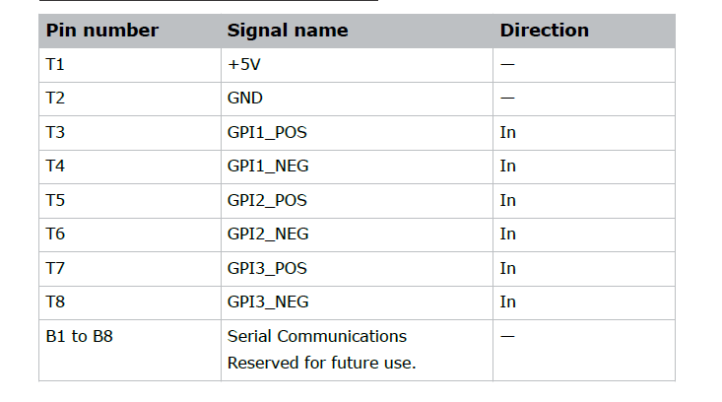
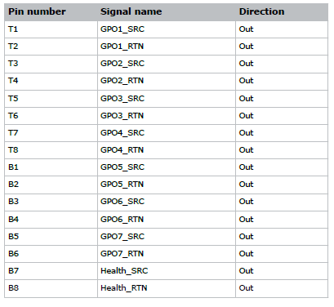
CineLife+ 2K System Overview
GPIO Connector Pinout:
Polarity of the GPO matters: There is a small
Voltage on the GPO_SRC pins. When switching an
External device, use the device's GND as the switched line connected to the (SRC).
If switching GPI on another Christie projector
Using the internal 5VDC, ensure GND is switched
Through the (RTN) and the (+) 5VDC is the common
GPO: 1 Amp, 24V DC Max
Notes:
This port can be used to control the Masking system and Dimmer controller.
Note, B7 and B8 are dedicated for heath output. This output is High only if the projector can play content, i.e. NO major error Fire Alarm Interlock opened or Service door switch opened errors are occurring. Otherwise the output turns low.
The 5V is meant for use to supply the Inputs, possibly the outputs if needed.
Health output is normally High Resistance (Open), it switches to Low Resistance (Closed) if:
The Fire Alarm Interlock is opened
LOS failures that prevents the system from turning the laser ON
DMD over temperature
Service door opened
Marriage is broken

Slide 32
CineLife+ 2K™ Electronics - Agenda
Previous Cinema Electronics Overview
CineLife+ 2K Cardcage Servicing
IMB and Marriage Connectivity
CineLife+ 2K Communications
CineLife+ 2K System overview
More

Slide 33
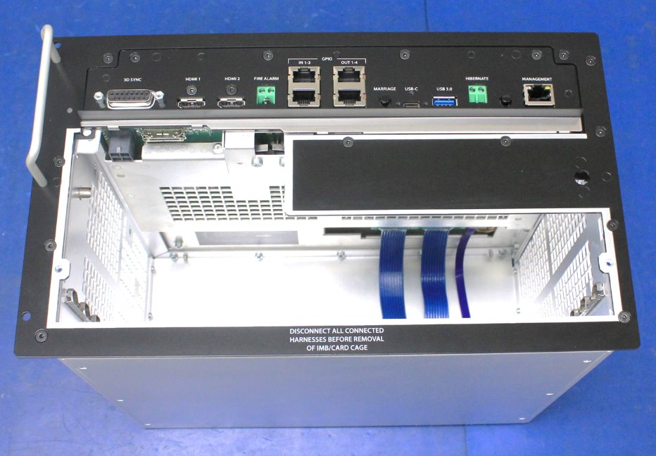
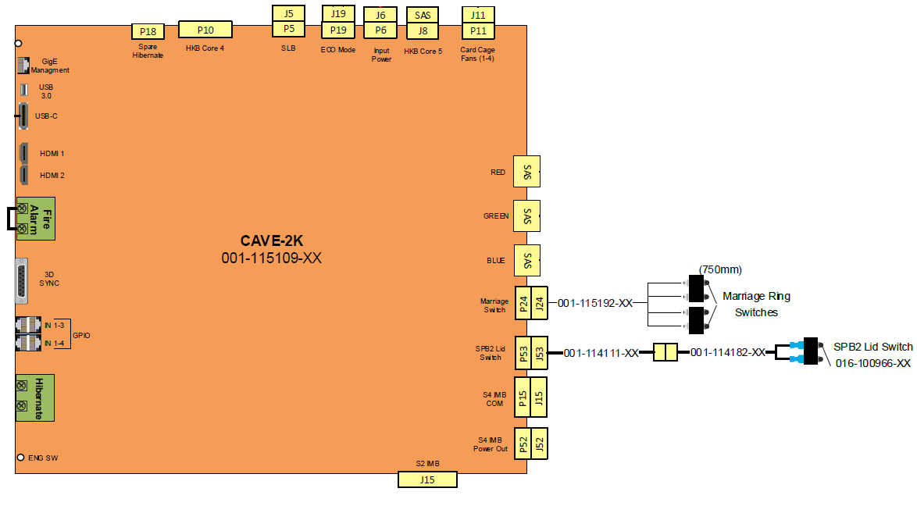
CineLife+ 2K System Overview
Marriage Switch:
Here we can see our IMB marriage switches:
Marriage Ring Tamper Switch
Notes:
In CineLife+ projectors, our VOM (Variable Option Interface) would contain the marriage switch and SPB2 Lid Switch.
Now, our CAVE-2K has these connections:
Marriage Ring Tamper Switch
Service Door Switch (Secure Processing Boundary (SPB2) switch)
Marriage Button/Switch (Secure Processing Boundary (SPB1)

Slide 34
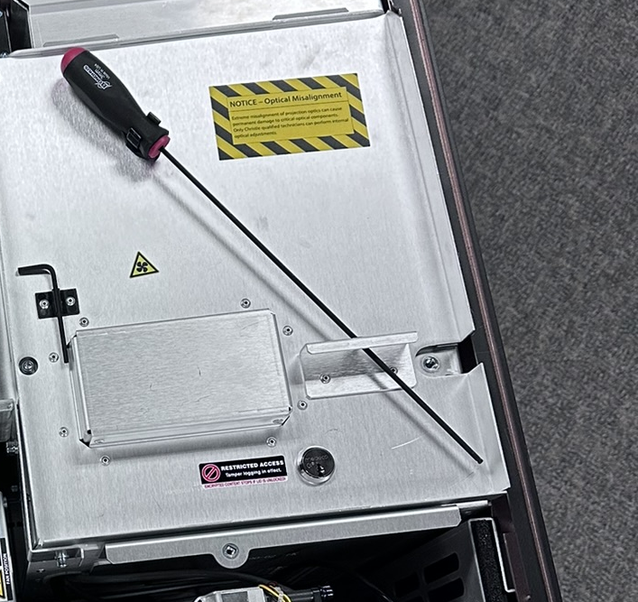
CineLife+ 2K System Overview
SPB2 Switch:
Here we can see our SPB2 switch:
SPB2 Tamper Switch/Lock
Notes:
In CineLife+ projectors, our VOM (Variable Option Interface) would contain the marriage switch and SPB2 Lid Switch.
Now, our CAVE-2K has these connections:
Marriage Ring Tamper Switch
Service Door Switch (Secure Processing Boundary (SPB2) switch)
Marriage Button/Switch (Secure Processing Boundary (SPB1)

Slide 35
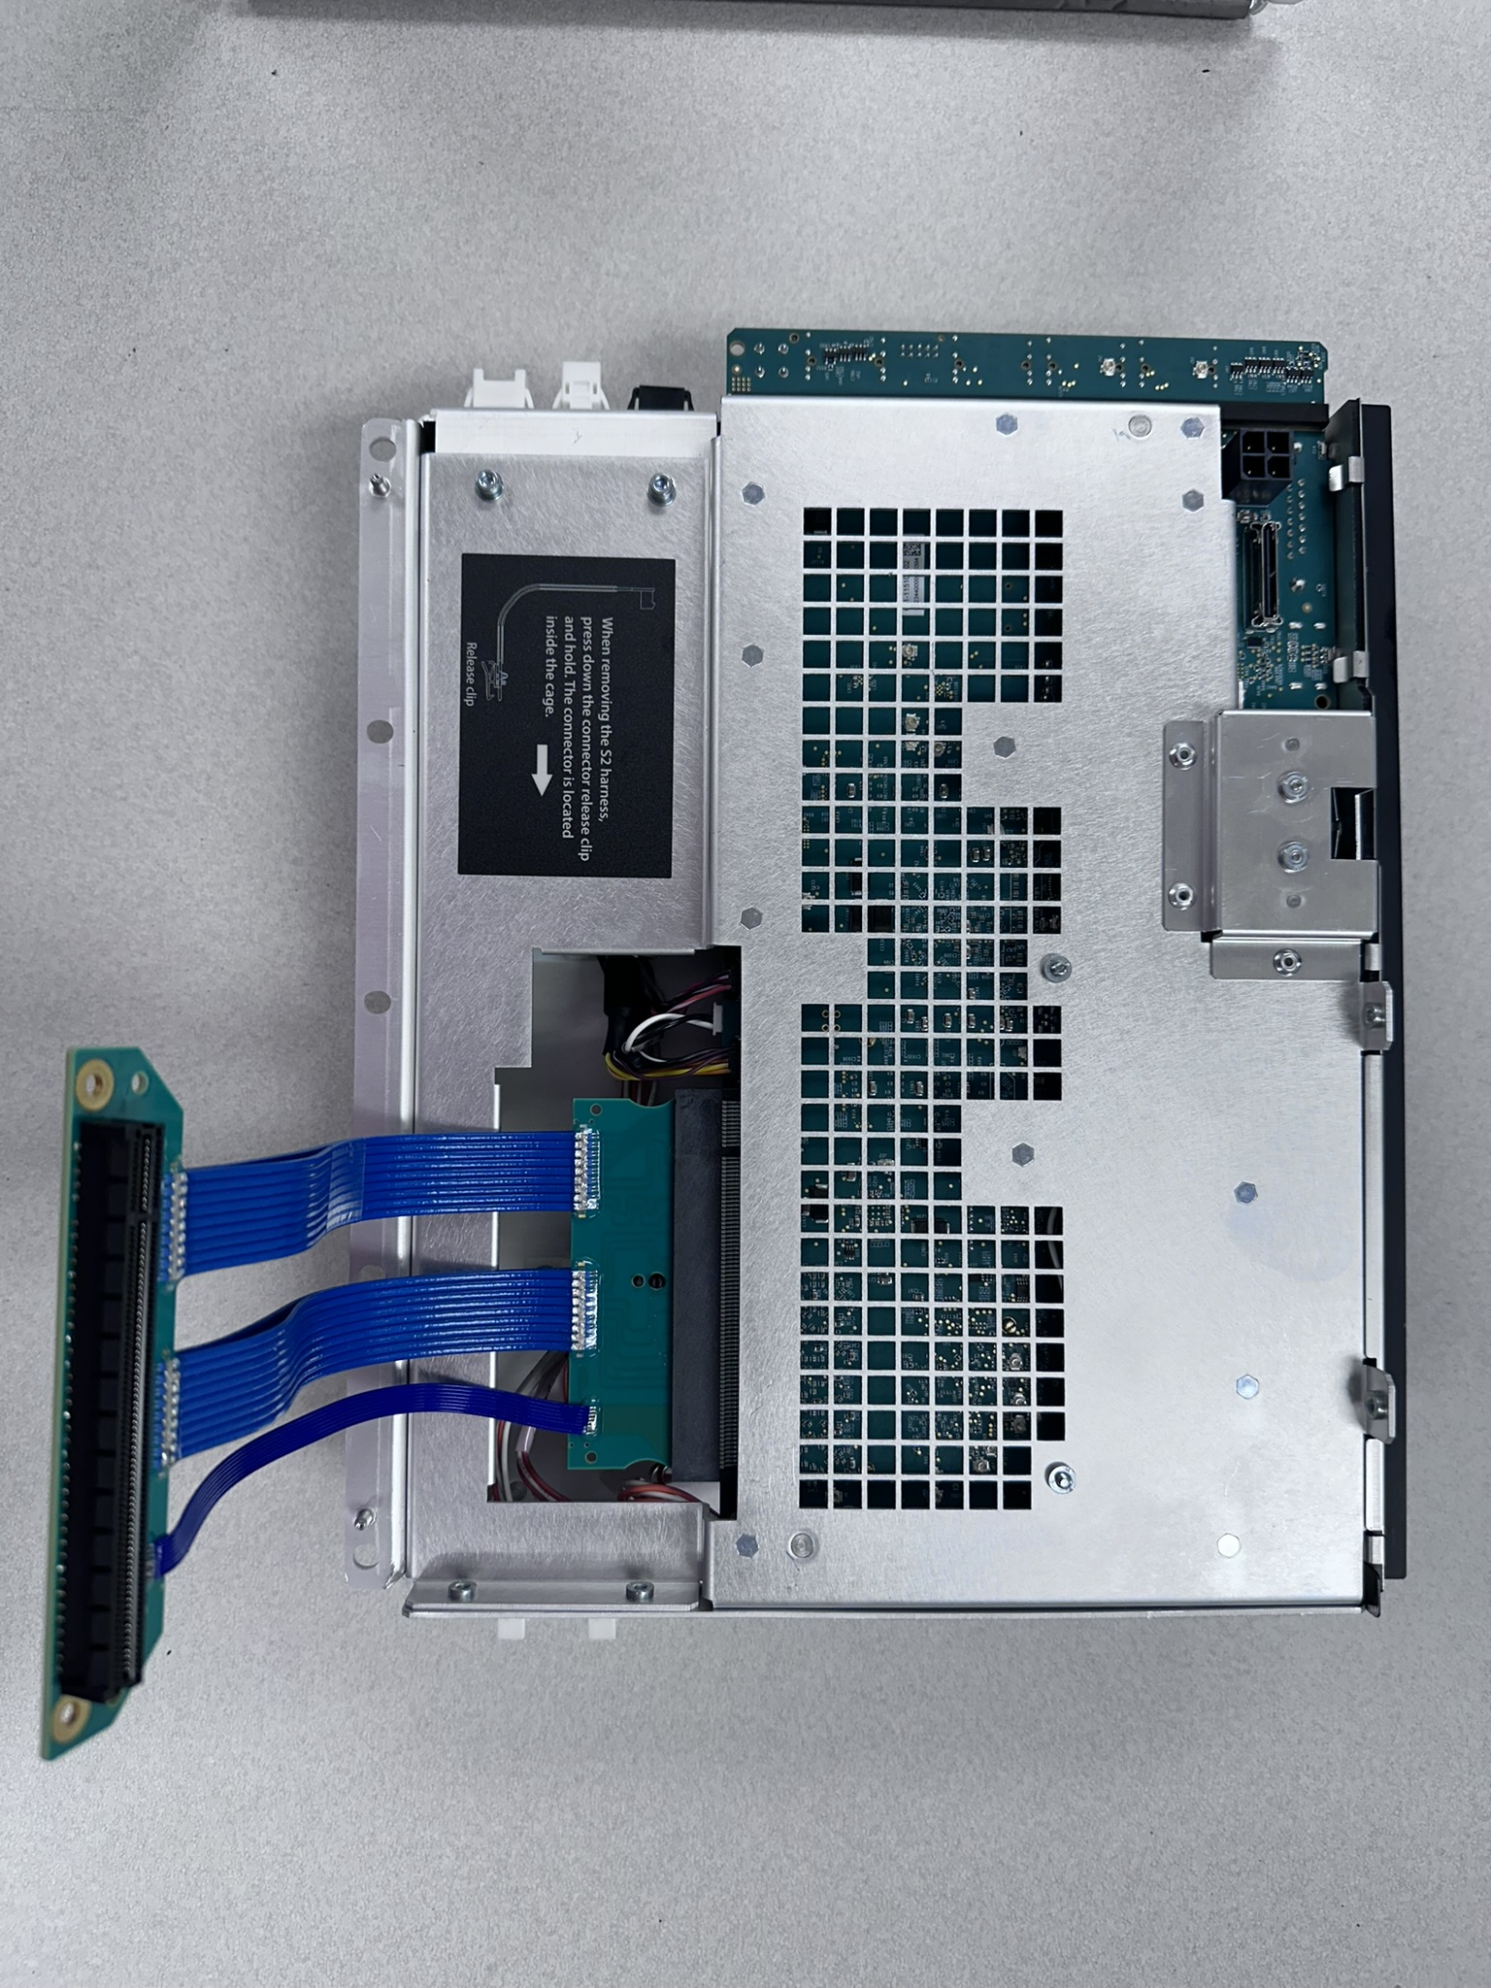
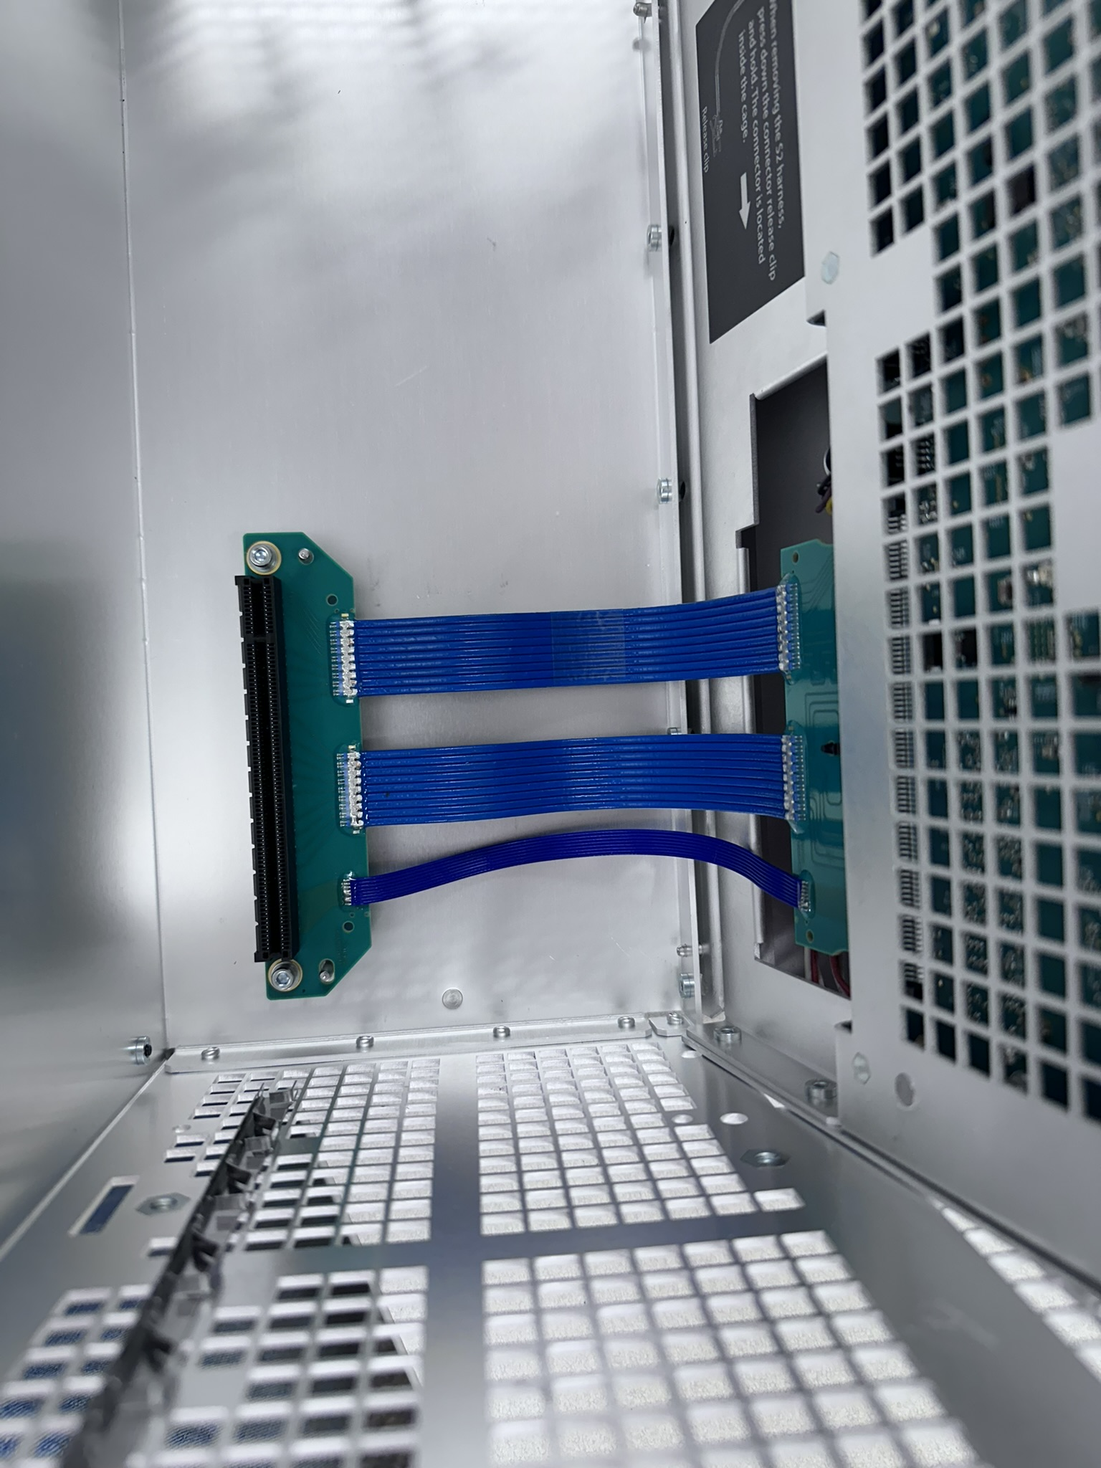
CineLife+ 2K System Overview
IMB Connectivity:
Here we can see our IMB connectivity:
Power for Series 4 IMB
Series 4 IMB Interface
Series 2 IMB Interface (Power and Signal)

Slide 36
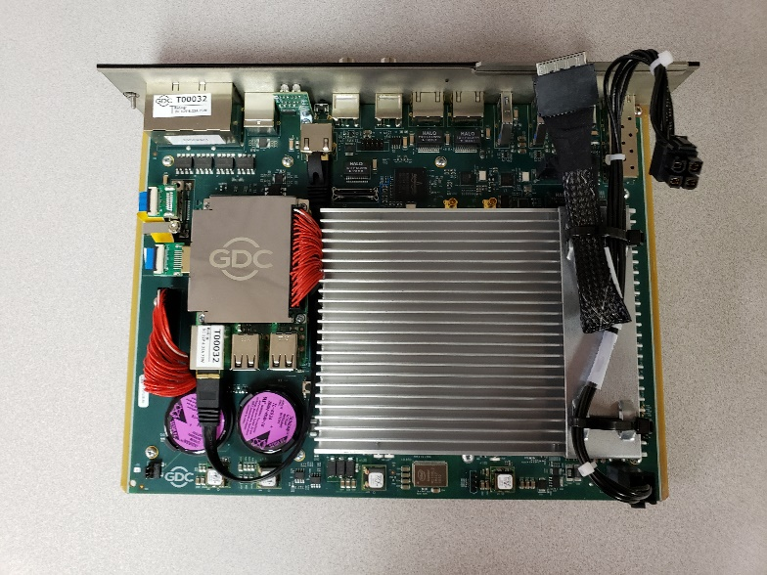
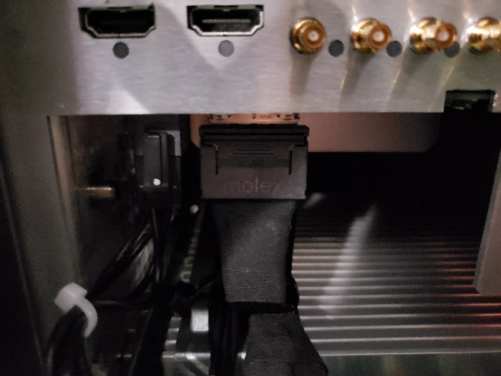
CineLife+ 2K System Overview
IMB Connectivity:
Here we can see IMB connectivity harnesses for power and communication:
Power
GDC-SR 6400 C
Signal
Note: Failure to connect the power harness may be perceived as an IMB failure since the rest of the Electronics will function as expected

Slide 37
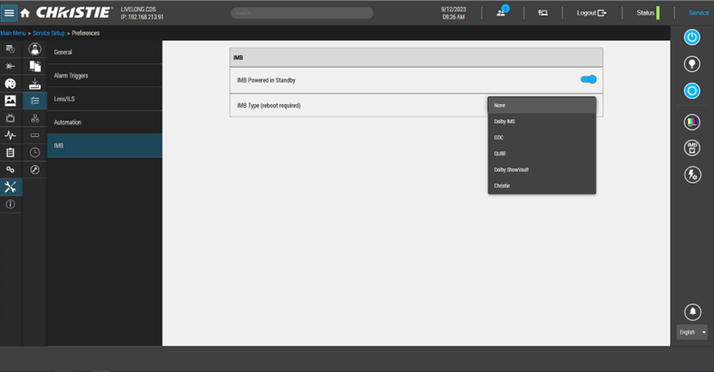
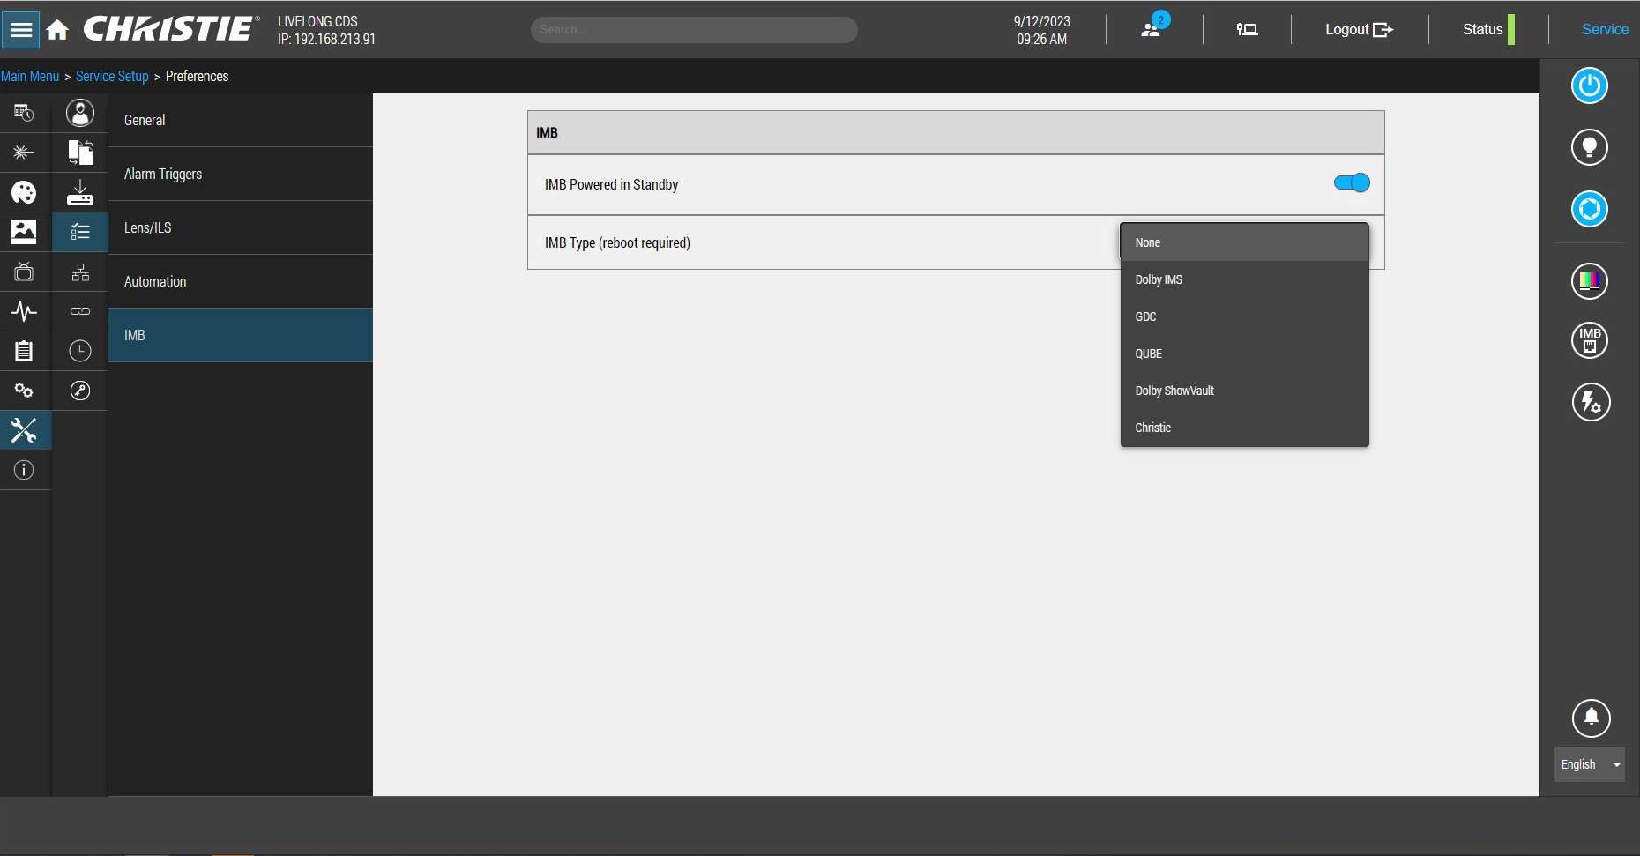
CineLife+ 2K System Overview
Selecting the IMB Type:
Installing an IMB must be done when the projector breaker is off.
After installing an IMB in a projector, you will need to specify the IMB type in order for the projector to connect properly.
The “Christie” selection is only for the IMB-S4 (this since, CineLife+ projectors do not support the IMB-S2 or IMB-S3).
Note: GDC has IMB’s that support the Series II Interface (ex: SR-1000) or the Series IV Interface (ex: SR-6400). If using a GDC and selecting GDC, the projector will auto detect between the Series II and Series IV interface.

Slide 38
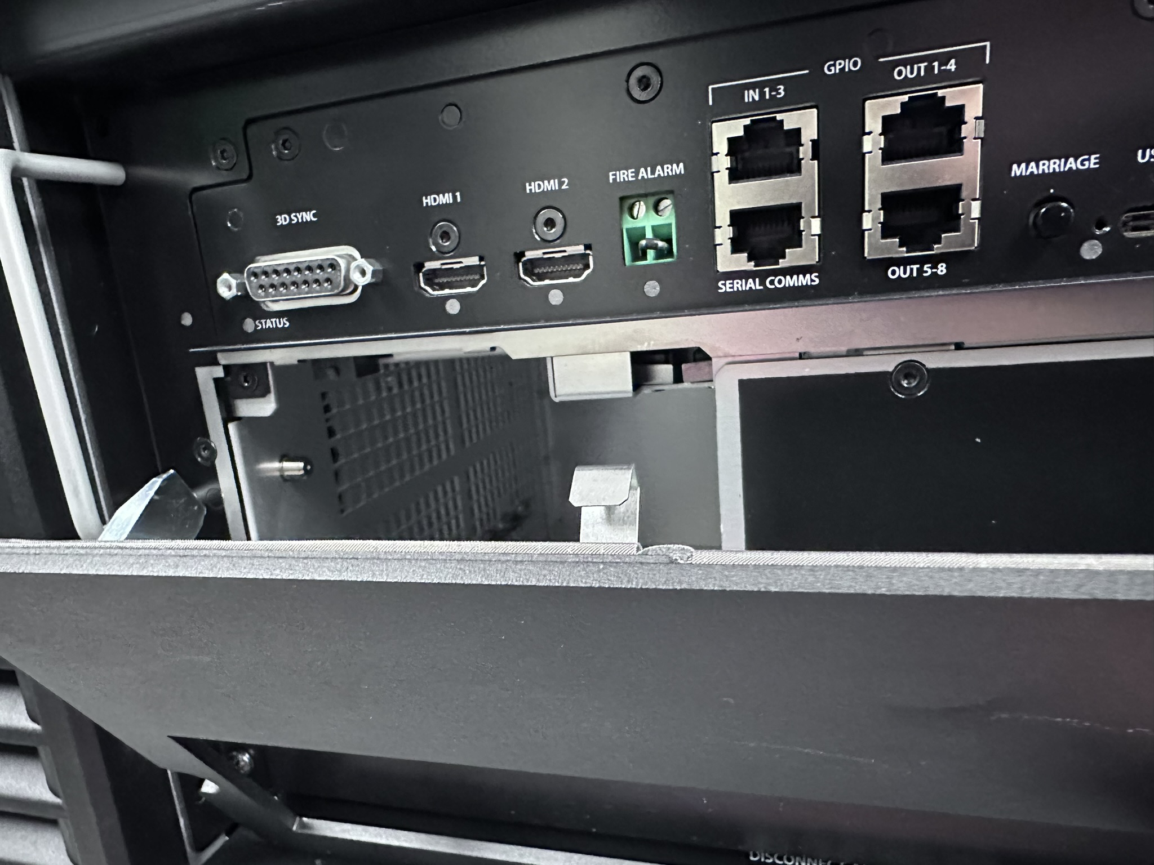
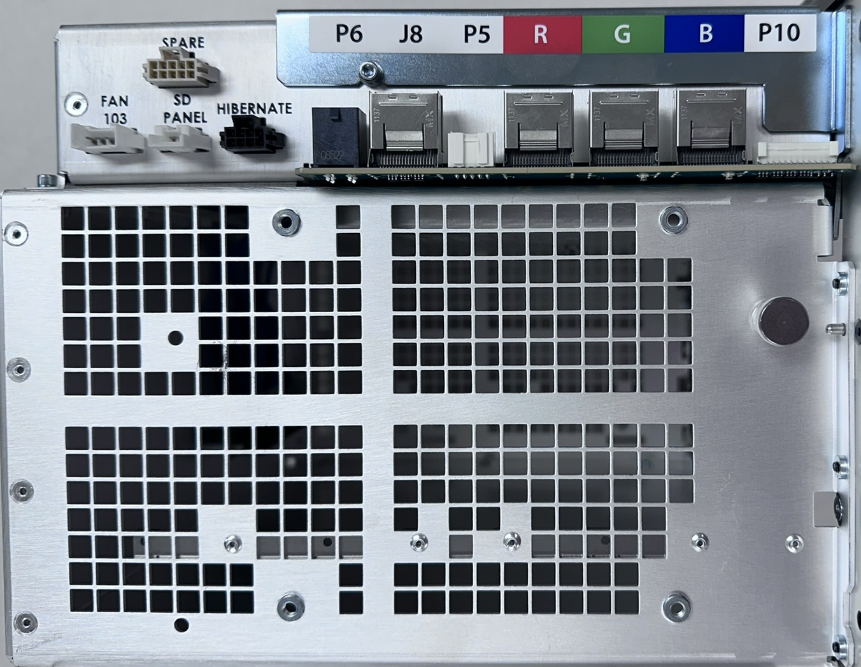
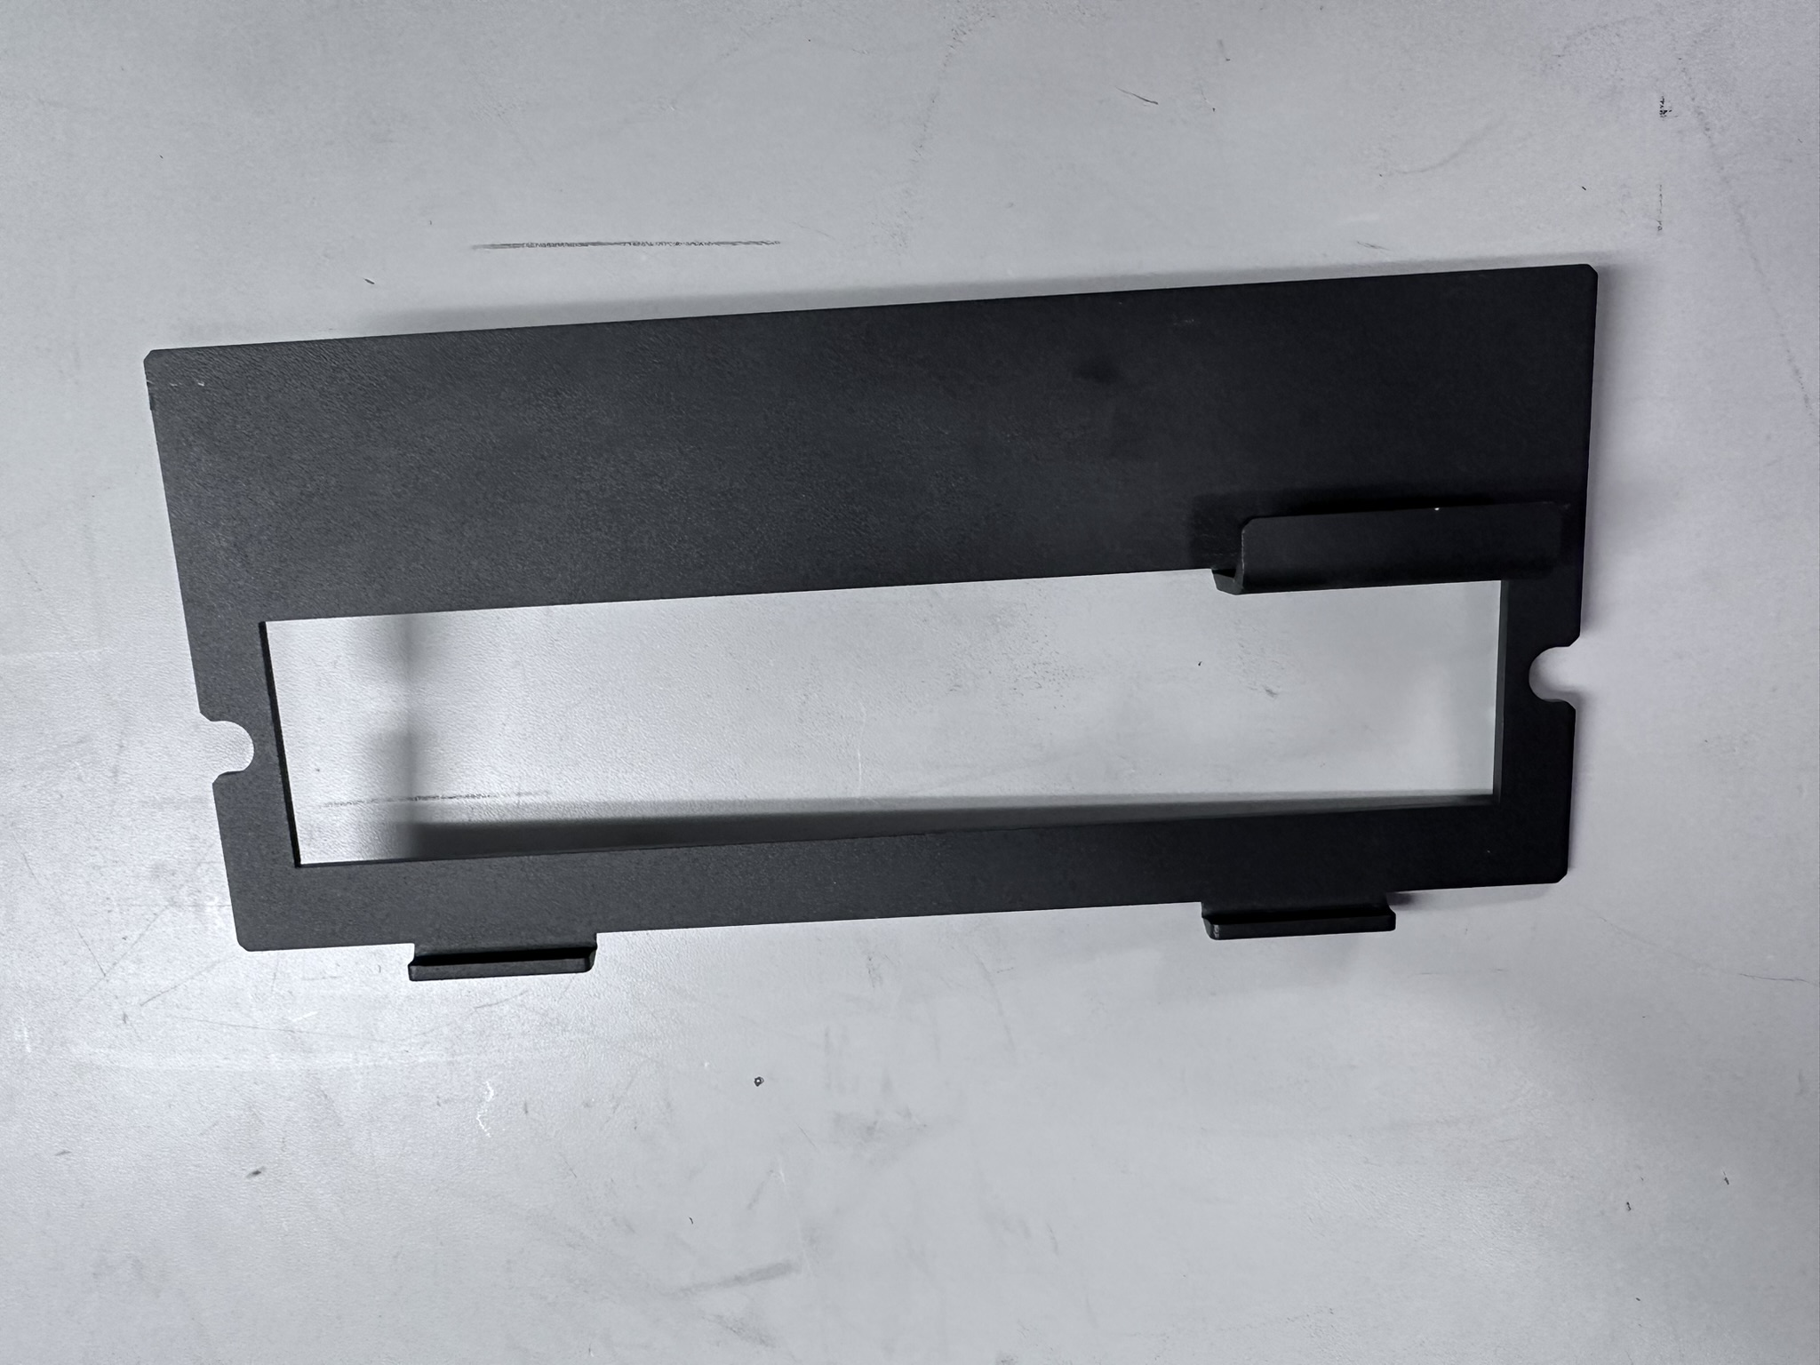
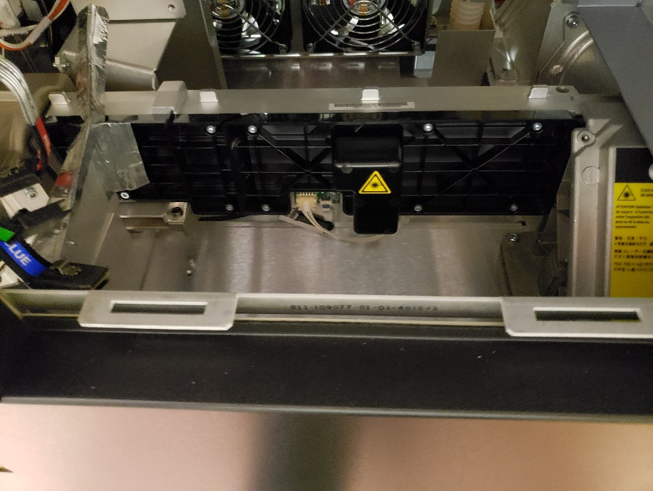
CineLife+ 2K System Overview
Marriage Ring and Switch
Here we can see our Marriage components:
Switch to detect if marriage ring is removed:
Latching pin
Pin to close the switch when the marriage Ring is installed
Marriage ring latches here
Note: The marriage Ring locks the Card-cage in place. To remove the Card-cage from the projector, the marriage ring has to be removed first
Notes:
In order for the Projector to play encrypted content, we have to arm the marriage between the Media Decryptor and the CAVE-2K (Secure Silicon Device).
The projector CANNOT play cinema content if the marriage is broken.
The removal of a the marriage ring will trip a switch connected to the CAVE-2K and monitored by the security manager.
If the switch is tripped, the SM will immediately delete the projector certificates, and if it was playing content, it will purge the KDMs and the playback will stop immediately.
The circuit on the SM that monitors the marriage switch and the service door switch is battery powered and it monitors the switch even if the projector is turned OFF.
The SM logs all security related events such as:
service door open/close
Marriage ring removal (marriage break, arming marriage)
Content playback
KDM checks and use
The marriage ring is latched in place. To unlatch it, the service technician must have access to the high security key to
Open the service door. This action will stop the playback
With the service door opened, the top cover latch can be operated to remove the top cover.
With the service door opened, the marriage ring latch can be operated to remove the ring. This action breaks the marriage.

Slide 39
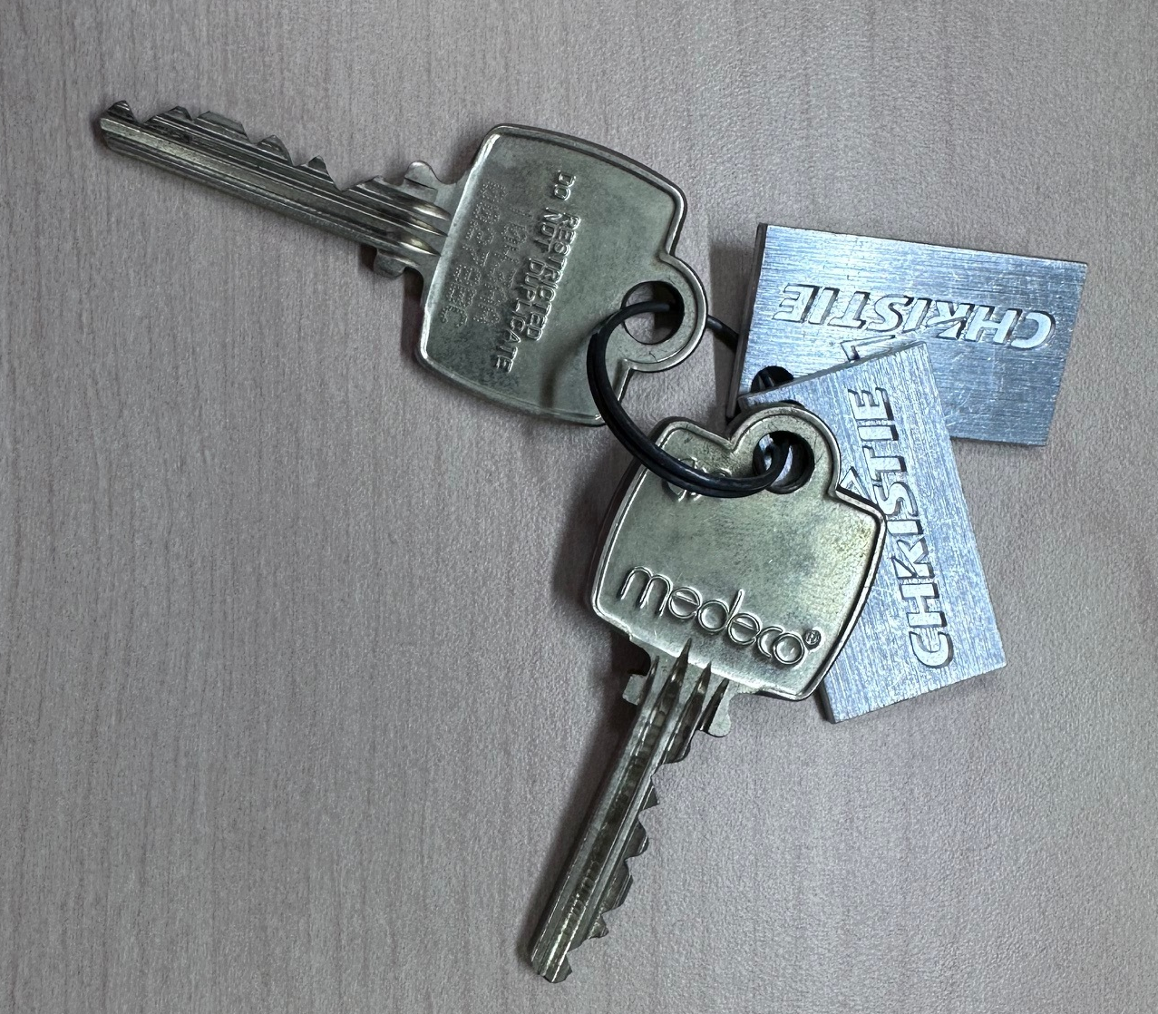
CineLife+ 2K System Overview
Secure Processing Boundary 2 (SPB2):
Unique to each projector, High Security Medeco Key
To open the service door (SPB2)
Switch operated by the high security key. Switch is monitored by the SM. If switch is opened, the SM stops the playback immediately (operating this switch does NOT break marriage)

Slide 40
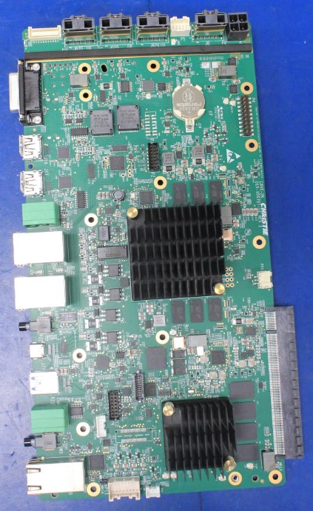
CineLife+ 2K System Overview
Certificates:
Notes:
Arming the marriage means, the Security Manager (SM) on the Integrated Media Block (IMB) will check the projector certificate on the CAVE-2K. A copy of this certificate will be kept on the SM.
Marriage break means the SM deleted the certificate of the projector (the certificate remains on the CAVE-2K). Marriage break condition occurs if the marriage ring is removed. The only reason for the marriage ring to be removed is to replace one of the parts inside the CineLife+ 2K card cage.

Slide 41

CineLife+ 2K System Overview
Marriage:
After installing an IMB, we must identify this via the User Interface:
Service >> Preferences >> IMB
Notes:
The installer MUST first select the IMB type then arm the marriage

Slide 42

CineLife+ 2K System Overview
Perform Marriage:
Once the IMB is selected, you’ll need to reboot the projector. After this you’ll be able to perform marriage by clicking: “Main Menu -> Service Setup -> Marriage Setup”.
Notes:
The username and password to perform marriage is:
Username: marriage
Password: wedl0ck ; Note that we are using a zero instead of an “o”.

Slide 43

CineLife+ 2K System Overview
Perform Marriage:
DCI requirements also include that no one can arm the marriage remotely. The idea is, the marriage authority must inspect the system and make sure covers are closed, no cables are soldered to any of the boards, no line of sight to any of the projector electronics etc.
When all conditions are met, the marriage authority will sign off and arm the marriage.
The Marriage Button is integrated on the VOM to be pressed when prompted during the marriage arming process.
Marriage Button

Slide 44
CineLife+ 2K™ Electronics - Agenda
Previous Cinema Electronics Overview
CineLife+ 2K Cardcage Servicing
IMB and Marriage Connectivity
CineLife+ 2K Communications
CineLife+ 2K System overview
More
Notes:
NOTE: Agenda items are hyperlinked to their respective slide.
The Menu icon in the top right corner will take you back to this slide.

Slide 45

CineLife+ 2K System Overview
HouseKeeping Board (Type “G”) - HKBG:
Our HouseKeeping Board is responsible for all monitoring the fan speeds, temperature sensors, etc.
It also drives many additional components such as the lensmount, lens, shutter, etc.
We have a direct connection between the HKBG and CineLife+ 2K cardcage.
If we cannot detect the HKB for any reason, the projector will not be able to boot up in order to protect itself from any high temperatures or issues

Slide 46


CineLife+ 2K System Overview
System ID (SID):
Projector identification information, such as; model, manufacturing date and serial number are stored on a memory chip connected to the HKBB.
..:: The system CANNOT function if this board is NOT installed or failed ::..
SID Board
Notes:
SID is connected to the House Keeping Board Type G (HKBG)
The SID stores basic system information such as:
Manufacturing date
Model name
System Hours
Serial Number

Slide 47




CineLife+ 2K System Overview
CineLife+ 2K:
The software runs on the CAVE-2K.
Everything can be done with or without the Touch Panel (TP) attached. If there is no Touch Panel, you need to use the User Interface.
The optional TP has one USB-C connection to the CAVE-2K for power and video signal
Note: Make sure the power switch on the back of the TP is ON when connected to projector
Notes:
NOTE: The 3 mounting screws that currently come with the Optional Series IV Touch Panel Service Kit are too big for the –RBe projectors. These screws are intended for the other Series IV models that were released prior to the –RBe models.
Christie will update the Optional Touch Panel service kits to include the 3 screws required for RBe models soon.

Slide 48

CineLife+ 2K System Overview
Software Upgrade:
CineLife+™ upgrade package includes all projector sub-systems software.
To upgrade the projector software
Prepare a USB formatted FAT 16 or FAT 32
Copy the software package to the USB drive
Connect the USB drive to the USB 3 port on the CAVE faceplate
Go to Service Setup >> System Upgrade
All packages on the attached drive will listed
Highlighted the required software package
Click Upgrade
The system will automatically reboot when the upgrade is finished
Notes:
The software package can be transferred to the projector using the USB ports on the CAVE, Uploaded from a laptop connection or FTP’d to the projector.
For FTP, use port number 21, the user name is ftpuser and the Password to ftptms

Slide 49
CineLife+ 2K System Overview
Hibernate Mode:
Allows the projector to draw less than 3 Watts while in this new standby type mode.
In order to put the projector in Hibernate mode, we must send a remote (PWR -2) command.
To wake up the projector from hibernate mode, we can use WoL (Wake On LAN) “Magic Packet”, press the black button beside hibernate, or simply use a GPIO to temporarily connect the two green connectors for a brief moment (ex: 1 second) on the Hibernate connector.
While in Hibernate mode, just about all parts of the projector are off.

Slide 50

Post-Training Survey
Post-Training Survey
Please scan the QR code via your mobile device,
or enter the URL to access the survey.
https://www.surveymonkey.com/s/ChristieU
© 2019-2020 Christie Digital Systems Inc. All rights reserved.
All brand names and product names are trademarks, registered trademarks or trade names of their respective holders.
Notes:
Survey’s should be completed on the final day of training.

